Slide 1

Patterns for Continuous Delivery, High Availability, DevOps & Cloud Native Open Source with NetflixOSS
Workshop with Notes
December 2013
Adrian Cockcroft
@adrianco @NetflixOSS
Notes:
Notes added to try and capture what I usually say for each slide

Slide 2
Presentation vs. Workshop
Presentation
Short duration, focused subject
One presenter to many anonymous audience
A few questions at the end
Workshop
Time to explore in and around the subject
Tutor gets to know the audience
Discussion, rat-holes, “bring out your dead”
Notes:
Unlike a presentation, where I talk and you listen, with some questions at the end, this is a workshop, and we have time to discuss the implications of the topics, get off track and address your own specific situations and problems. “Bring out your dead” is a reference from the film Monty Python and the Holy Grail.

Slide 3

Presenter
Adrian Cockcroft
Biography
Technology Fellow
From 2014 Battery Ventures
Cloud Architect
From 2007-2013 Netflix
eBay Research Labs
From 2004-2007
Sun Microsystems
HPC Architect
Distinguished Engineer
Author of four books
Performance and Capacity
BSc Physics and Electronics
City University, London

Slide 4
Attendee Introductions
Who are you, where do you work
Why are you here today, what do you need
“Bring out your dead”
Do you have a specific problem or question?
One sentence elevator pitch
What instrument do you play?
Notes:
It’s important in a workshop to “loosen up the audience” and it’s worth spending the time to go around the room and get everyone to say who they are and why they are here. Having everyone hear their own voice in the room is a good way to get a much more interactive workshop. For fun, we throw in a musical question, if you don’t play an instrument, perhaps you could say what kind of music you like.

Slide 5
Content
Cloud Native NetflixOSS
Questions and Discussion
Resilient Developer Patterns
Availability and Efficiency
Cloud at Scale with Netflix
Notes:
This content takes a whole day to explore. Last time it was given, Ben Christensen provided his own slides on resilient developer patterns that go into much more depth than I do.

Slide 6
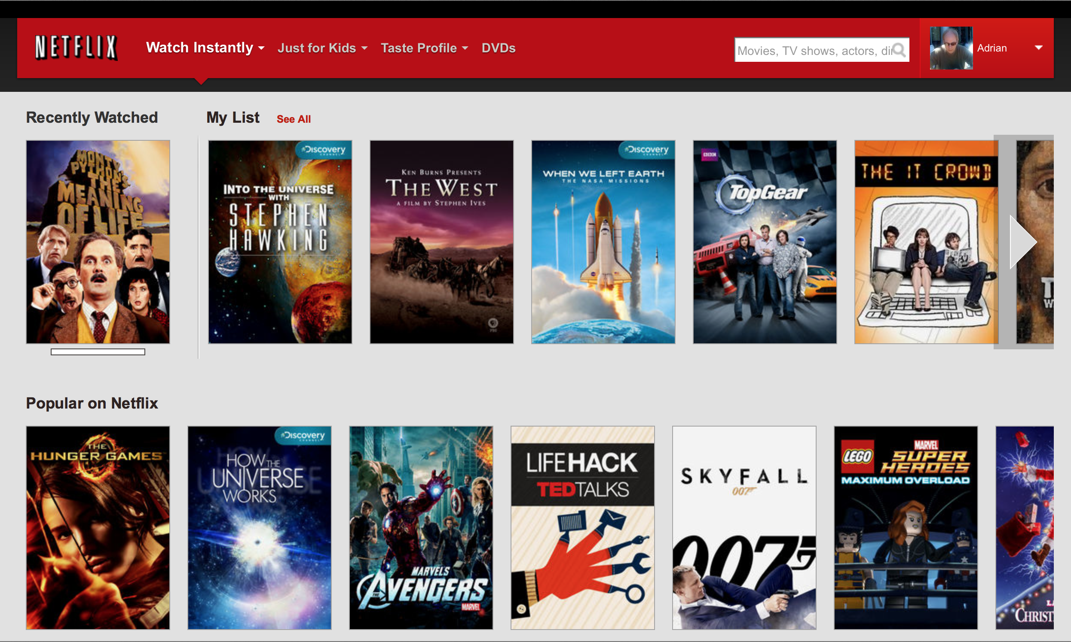
Netflix Member Web Site Home Page Personalization Driven – How Does It Work?
Notes:
When you are a Netflix member and you visit the site with a web browser, this is what you see. At the top right you see a profile icon that I automatically get by connecting my Netflix profile to my Facebook account. Below that is the video I last watched, a list of videos I saved to watch later, that has been sorted for me by Netflix, and a row showing what is currently popular on Netflix. There are another 10-20 different kinds of rows of videos if you scroll the page down. The popular on Netflix row is different for everyone who loads this page. There are clusters of users so that people who watch a lot of SciFi would get a different popular row from people who watch mostly drama. The site can also filter out things I’ve watched recently and sort based on what I am most likely to want to watch next.

Slide 7
How Netflix Used to Work
Customer Device (PC Web browser)
Monolithic Web App
Oracle
MySQL
Monolithic Streaming App
Oracle
MySQL
Limelight/Level 3 Akamai CDNs
Content Encoding
Content Management
Consumer Electronics
AWS Cloud Services
CDN Edge Locations
Datacenter
Notes:
This is how Netflix worked in the early days of streaming. We had a monolithic web application with mostly an Oracle back end, and a few bits of MySQL. We made a second monolithic app to handle the streaming back end for playing content via web browsers, and all movie choosing took place on the web site. The whole application ran in two datacenters with manual failover between them if anything went wrong. The streaming data was served by the largest capacity commercial Content Delivery Network services – Limelight, Level 3 and Akamai. Content was managed in the datacenter and a few racks of systems in the datacenter encoded the content for delivery by the CDN.
Of course this is a simplified view, in reality the very first CDN solution was built in-house but it soon ran out of capacity and we were able to get CDN vendors to support us. This is what it looked like just before the move to cloud.

Slide 8
How Netflix Streaming Works Today
Customer Device (PC, PS3, TV…)
Web Site or Discovery API
User Data
Personalization
Streaming API
DRM
QoS Logging
OpenConnect CDN Boxes
Content Encoding
CDN Management and Steering
Consumer Electronics
AWS Cloud Services
CDN Edge Locations
Datacenter
Notes:
This is a very simplified view of today’s architecture, you can see that there is no grey datacenter left, there is only orange AWS cloud. This applies to the systems used to support using the Netflix streaming service. There is still a datacenter based DVD service and a shared billing system, although billing is in the process of moving to the cloud too, and the DVD service has to call the cloud to get access to some of the shared data because the master copies are in the cloud.
There are many more customer device types, over 1000 different products. They connect to a discovery API to build their video choosing interface, and we also have the web site for browsers. Behind that is a large and complex set of microservices that aren’t shown in detail here. They hold user data, run personalization algorithms, do Distributed Rights Management (DRM) and Quality of Service (QoS) logging. The CDN is now primarily using Netflix built OpenConnect boxes that are managed by AWS based backend services and content encoding is also performed on AWS and pushed to the CDN.

Slide 9
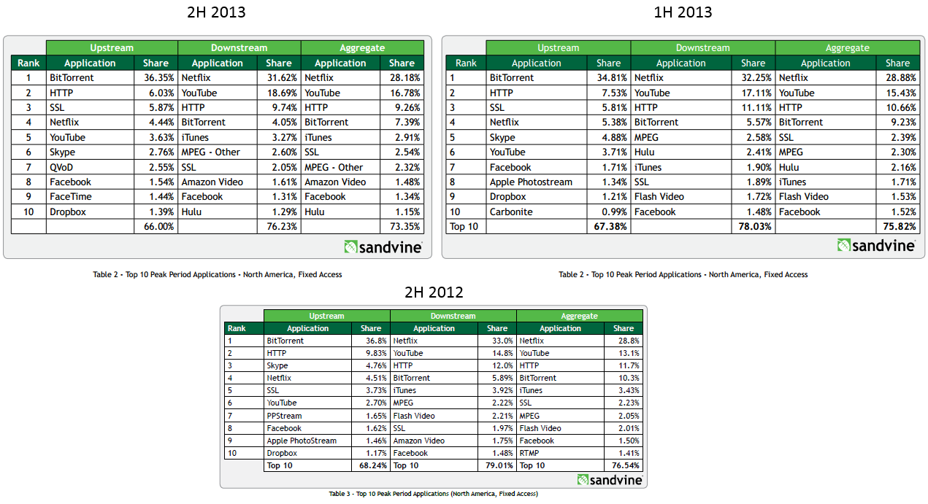
Notes:
The reason Netflix moved to our own CDN is that we outgrew the Terabit scale commercial vendors and had to build our own CDN that is the highest bandwidth CDN in the world. Here’s some evidence for that. Sandvine make network hardware used by ISPs and measure the source of traffic on those ISPs in aggregate to make this report.
The data shown here is for North America, fixed access for six month periods. i.e. it does not include mobile, and it’s not world wide. That data is also in the full report.
It shows that Netflix was about a third of all the bandwidth delivered to houses in the USA over the last year and a half. A note on the most recent one where Netflix dropped a few percent is that Netflix turned on SuperHD for everyone at the end of that period, and they already saw the percent increasing for the next measurement period. In 2014 we will be streaming in UltraHD 4K and increase it further.
The total bandwidth increased by 39% from 2H 2012 to 1H 2013, and it is many Terabits, dominated by Netflix and YouTube.

Slide 10
Netflix Scale
Tens of thousands of instances on AWS
Typically 4 core, 30GByte, Java business logic
Thousands created/removed every day
Thousands of Cassandra NoSQL nodes on AWS
Many hi1.4xl - 8 core, 60Gbyte, 2TByte of SSD
65 different clusters, over 300TB data, triple zone
Over 40 are multi-region clusters (6, 9 or 12 zone)
Biggest 288 m2.4xl – over 300K rps, 1.3M wps
Notes:
Netflix is one of the largest deployments on AWS, to support global streaming we have tens of thousands of instances. The most common size for business logic is around 30GB of RAM and four cores running a single huge JVM. It’s mostly been m2.2xlarge but a transition to the newer m3 instance types is under way. The exact number of instances is constantly changing, it scales down a lot overnight, and thousands are replaced every day due to code pushes. A wide range of instance types are used, sizing the instance to the application is discussed at the end of this slide deck.
The data storage tier is primarily based on the Apache Cassandra NoSQL data store using the internal disk space in each instance. We initially ran Cassandra on m2.4xlarge instance types with 68GB RAM and two hard drives each. The extra memory helped compensate for the lack of IOPS. When AWS came out with the SSD based hi1.4xlarge instances we were the early heavy user of them and we have transitioned our most critical Cassandra clusters to SSD now.
We denormalize our data model, so each Cassandra cluster holds what would be a single table or materialized view in a relational schema. That lets us update and scale each data source independently. We’ve ended up with 64 distinct single function clusters and one that holds a grab bag of small workloads that don’t justify their own clusters. The total data store (as of November 2013) is over 300TB and all data is stored in three zones in each region. We require a quorum of two out of three copies to be online to provide service. Over 40 clusters are multi-region, so they have an additional three copies of the data in each region. The regions are US East and US West 2 for our primary service, EU West for Europe and we have a few Cassandra services deployed in US West 1 that support tooling and deployment operations.
The single biggest cluster type uses 288 m2.4xl instances, we just scaled it up from 144. It’s running over 300,000 reads per second and 1.3 million writes per second. They are single region clusters handling logging information, we have one each in the US East and US West region.

Slide 11
Reactions over time
2009 “You guys are crazy! Can’t believe it”
2010 “What Netflix is doing won’t work”
2011 “It only works for ‘Unicorns’ like Netflix”
2012 “We’d like to do that but can’t”
2013 “We’re on our way using Netflix OSS code”
Notes:
I started giving talks on what Netflix was doing in cloud in 2009. The first few times I presented the reaction was incredulous. People didn’t believe we would be attempting something so crazy.
By 2010 as the migration continued the reaction shifted to accepting that we really were doing cloud, but that it wouldn’t work. We would be back building datacenters soon enough.
In 2011 we had finished migrating Netflix to cloud and it was working well enough that people could see that it was an interesting thing to have done, but the consensus was that this was not relevant to anyone else in the industry. Netflix was a unique Unicorn case.
The agility and speed of deployment started to win converts, and in 2012 the most common comment was that people would like to be doing what Netflix was doing in cloud, but there was no way to bridge the gap from where they were now, to where they needed to be.
Netflix agressively open sourced it’s Cloud Native platform in 2012 and 2013, ending the year with 39 projects on Github. When I met with companies in 2013 it became common to find that they were already using some parts of NetflixOSS and were working on how to use more.

Slide 12
Objectives:
Scalability
Availability
Agility
Efficiency
Notes:
These are the guiding objectives that Netflix has for its infrastructure platform.
We need scalability, so we can grow our customer base and traffic, currently around 40Million and growing fast on a global basis. To launch a new country, or to scale up to beyond 100 million should be a simple increase in the number of instances, not a new architecture.
We need availability. When providing an entertainment service customers expect their TV set or iPad to just work whenever they want to use it.
We need agility for our developers. The faster we can build and deploy new features, the more competitive Netflix is in its market.
Finally, we need efficiency, but this is subordinate to the other objectives. We don’t want to waste capacity, but it’s a late optimization to find the most inefficient parts of our infrastructure and improve them. It’s a false economy to slow down development to save money. We get immediate payback from our tuning and autoscaling efforts. The end of this talk covers ways to use cloud efficiently.
Most of Netflix’s revenue is spent on licensing content. In a company that has higher infrastructure costs as a proportion of revenue and a slower growth or innovation rate the order of these objectives would be different.

Slide 13
Principles:
Immutability
Separation of Concerns
Anti-fragility
High trust organization
Sharing
Notes:
Here are some general principles to keep in mind. They can be applied in many areas as they have a broad effect on how to solve problems.
Immutability is the magic pixie dust of distributed systems. Problems that are impossible to solve or have nasty corner cases become tractable once you sprinkle some immutability on them. There are examples in functional programming, the storage architecture of Cassandra and the code deployment mechanisms. One key thing immutability gives you is it lets you reference, replicate and cache safely, knowing that the thing you are referencing or replicating won’t change. It may be deleted, but handling that is a far simpler problem than tracking mutable state.
Separation of concerns is important for scaling developer teams, for creating highly available systems and for any time you need to something quickly. Synchronization, hand-off delays and false sharing can be avoided.
Anti-fragility is becoming better known as a label, but it’s an old concept. Failure injection or stress testing, chaos monkeys, work-hardening, no-pain no-gain and human exercise are good examples. The concept is that you need to artificially stress your systems enough to find their weak spots, but not to destruction.
The high trust organization is very hard to get to and maintain, but has huge benefits across a wide range of activities. Its probably the thing that most distinguishes big old organizations from small new ones. The big old organizations have rules and processes because they can no longer trust their employees. A well run startup or a mid-size (~1000 person) organization like Netflix that carefully hires only senior people and trusts them has a huge amount of friction and time removed from daily operations. The default assumption at Netflix is to trust that everyone around you has excellent judgment and can figure out what to do themselves, if provided with the correct context. Management overhead drops, speed of decision making increases, outcome quality improves. Poor judgement, or lack of trust in other people isn’t tolerated, so people who need to be closely managed and also people who can’t stop being micromanagers have to be removed from the organization.
Making sharing the default is important in many ways. In the organization sharing builds trust. People who tend to over-share are more effective than those that disappear into their cube and emerge when they are done. The big challenge of teleworking or work from home is the impact on sharing, it requires a lot more effort to let people know what’s going on. This is one reason for the Netflix policy of having everyone work on the same site, where possible. Sharing also helps you test your own thinking. The many talks on Netflix architecture and open source projects that have been shared are a great source of feedback on whether the ideas are good, and have helped refine and steer further development.

Slide 14
Outcomes:
Public cloud – scalability, agility, sharing
Micro-services – separation of concerns
De-normalized data – separation of concerns
Chaos Engines – anti-fragile operations
Open source by default – agility, sharing
Continuous deployment – agility, immutability
DevOps – high trust organization, sharing
Run-what-you-wrote – anti-fragile development
Notes:
Applying these objectives and principles gave rise to some of the outcomes that are part of the Netflix Cloud Native architecture.
Public cloud is used because it has built in scalability, agility and gets it by sharing capacity with other organizations.
Micro-services is a powerful use of separation of concerns that increases agility and availability
De-normalizing data sources separates the concerns to make each data source scalable and available
Chaos engines like the Netflix Chaos Monkey prevent your systems from getting fragile
Using and making platform code open source by default provides greater agility when adopting and fixing packages from outside, and sharing the code helps improve code quality and documentation, with external feedback on whether the ideas are any good.
Continuous deployment increases agility, and heavy use of the so-called “immutable server pattern” isolates failures and makes them more recoverable.
DevOps addresses lack of trust between development and operations by sharing tools and responsibilities. It can either be done by having both organizations work together and trust each other, or it can be done by merging development and operations functions into a single team. If operations led, that can mean operations teams developing automated build systems and deployment mechanisms on their own infrastructure. If developer led, that can mean developers learning to deploy and operate themselves with cloud based tooling.
Run-what-you-wrote then leads to anti-fragile development, because nothing makes a developer build reliable scalable and operable systems better than setting them up as the first entry in the pagerduty call tree for their micro-service.

Slide 15


When to use public cloud?
Notes:
Despite my reputation as an advocate for public cloud, there are situations that it’s not the best choice for.
A major part of public cloud value is that infrastructure is shared with others. That assumes that you are a small fish in a big pond. If you find that you are the biggest user or majority user of a service (SaaS, PaaS or IaaS) then you should be worried, because you are now a big fish in a small pond, and you aren’t getting as much benefit in in terms of headroom and co-operative investment from the ecosystem. The danger is that you become a shark in a paddling pool, and run into scalability issues and have no-where to go other than to a different cloud or on-prem, which is a lot of hassle. This is one reason Netflix runs on AWS, it would be a shark anywhere else. From time to time Netflix has “broken the elastic” and become a bit too big to be comfortable on a specific AWS feature, but so far AWS has scaled up as needed. There are some AWS features like their CloudFront CDN where Netflix was already too big to fit and has never used it.
For companies of the scale of Google, they have been bigger than AWS, so it doesn’t make sense, and they run their own public clouds. For small cloud vendors, they have to find a niche feature or market, or stick with small customers only.
The move during 2013 was pretty clear to me, in discussions with big organizations, they all have an AWS strategy now. Many have Azure strategies, a few are keeping an eye on Google, and there are a few specialized use cases on a small scale for other vendors.

Slide 16
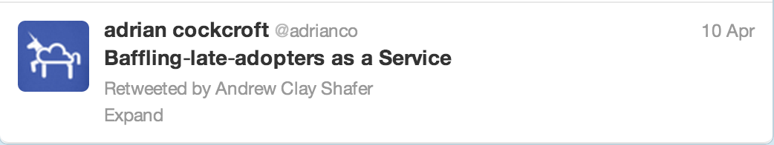
Notes:
Over the last few years I’ve been giving this talk to many difference audiences, while many can use it directly, there have been a lot of late adopter companies where the chasm is too big between where they are and the patterns I’m talking about. How can people make that transition, and what are the root assumptions that are getting in the way?

Slide 17

"This is the IT swamp draining manual for anyone who is neck deep in alligators." - Adrian Cockcroft, Cloud Architect at Netflix
Notes:
That’s the quote I provided for the back of this book. It’s a novel. A horror story for geeks. Well known novel “The Goal” updated for the current age.
The setting of the book is a medium sized manufacturing company struggling with the demands of IT.
It opens with an IT manager getting a call that his VP and CIO have quit, WiFi is down, and payroll is corrupted, he has an immediate meeting with the CEO when he gets there. He is reluctantly put in charge of fixing things but it carries on going downhill for most of the book. In the end he is saved by DevOps of course, but you have to read it and give a copy to your CEO.
But what happened to make IT such an issue?

Slide 18
Goal of Traditional IT: Reliable hardware running stable software
Notes:
The starting assumption for traditional IT.
Hardware works software can be tested until it works.
If hardware fails complain to your hardware vendor and get them to fix it
If software fails complain to your developers and software vendors until they fix it.
Rinse and repeat.
Grumble a lot.
Unfortunately this is a fantasy goal that can’t be reached.

Slide 19
SCALE
Breaks hardware
Notes:
Hardware isn’t perfect, if you have enough of it, some of it will be broken. Look at Telco’s as an example of large scale highly available services containing enough redundancy to work around hardware failures. However Telco industries have solved the software problem by moving at glacial pace and testing everything.

Slide 20
….SPEED
Breaks software
Notes:
Code will work most of the time, but there isn’t time to test everything that might happen so it will always break. The faster code is delivered, the less testing time there is and there are more opportunities for it to break. Look at startups for examples of rapid development practices. For startups, they usually have relatively little hardware, so they depend on that to be mostly reliable.
However If you tell me your software never breaks, you could be going faster….

Slide 21
SPEED at SCALE
Breaks everything
Notes:
“Web scale” organizations are running at large scale, with broken hardware, and with high speed deployments that break software.
This is the biggest disconnect that the enterprise transformation has to overcome. The base assumptions have to be reversed. To be competitive you need to be able to survive deploying broken code like a startup, on broken hardware that’s scaled like a Telco.

Slide 22

Notes:
Here’s the problem, let’s say a snowmageddon hits the north-east of the USA and the schools and many businesses close. It now becomes vitally important that Netflix keeps working to distract those kids, and many of the adults.
Alternatively you don’t want people to have to try to explain to a four year that their favorite show isn’t available because Netflix is down.
(Stan at Netflix made this graphic)

Slide 23
Cloud Native
What is it?
Why?
Notes:
Traditional enterprise architecture is based on the wrong premises for this transformation.
Next I will explain what cloud native architecture looks like and and why.

Slide 24
Strive for perfection
Perfect code
Perfect hardware
Perfectly operated
Notes:
Engineers always want to write perfect code, run it on perfect hardware, and operate it perfectl.

Slide 25

But perfection takes too long
Compromises…
Time to market vs. Quality
Utopia remains out of reach
Notes:
However those pesky deadlines get in the way, it takes too long to debug the code, the hardware is flaky, and there wasn’t time to document and train everyone on how to run it. Quality suffers, and there is always a big push to slow down to get it right, but unless you are trying to land a mini on Mars from a skycrane you won’t have time to make it be perfect.
Instead we could optimize for a different end of the tradeoff, do everything as fast as possible, assuming that there will still be bugs and broken hardware, but be very good as masking those problems so customers don’t notice.

Slide 26
Where time to market wins big
Making a land-grab
Disrupting competitors (OODA)
Anything delivered as web services
Notes:
If you can get to market very quickly you can make a land grab to get ahead of or disrupt your competitors. You can speed up your ooda loop, especially for anything delivered as web services.
Some of you are asking, what’s an ooda-loop?

Slide 27
INNOVATION
Land grab opportunity
Competitive move
Observe
Orient
Decide
Act
Measure customers
Customer Pain Point
Engage customers
Analysis
Deliver
Colonel Boyd, USAF
“Get inside your adversaries' OODA loop to disorient them”
BIG DATA
Implement
Model alternatives
CLOUD
Plan response
Commit resources
CULTURE
Get buy-in
Notes:
In the Korean war, Colonel Boyd of the USAF (the Sun Tsu of the modern era) was teaching his pilots how to be the one that comes home from a dogfight. “You have to get inside your opponent’s OODA loop to disorient them”. If they could see what was happening, orient themselves, decide what to do and act faster than their opponents, then the opponent would be reacting to what they did previously and would be outmaneuvered.
In a competitive business context you want to look for a land grab opportunity, see a competitive move or notice a customer pain point.
To orient yourself you need to analyze the idea and model alternatives.
Next plan the response, get buy-in from everyone and commit the resources to do the work.
Finally, implement the idea, deliver it, engage customers with an A/B test, email campaign or online ad-buy, and loop back around by measuring their response.
The first of these is called Innovation by many companies, especially those that can’t figure out what to do next and have a cultural “innovation problem”.
The orientation phase is basically “Big Data” and the key difference from traditional business intelligence is that I want to know the answer to a question that has never been asked before, and want an answer as soon as possible! That means rapidly processing huge log files or unstructured data sources to find out exactly how many customers have the same pain point you noticed, or might be interested in what your competitor is now offering.
The decision process at a company is driven mainly by company culture. If every decision has to be reviewed by a series of committees, or the CEO has to review everything that gets done then you have major road blocks slowing you down. Flat high trust organizations that share what they are doing but don’t seek approval or try to block things can move incredibly quickly.
If the first three steps are going quickly, you don’t want to get bogged down waiting for resources for development and deployment, so the last part is where cloud comes in. You develop on the same exact platform with unlimited resources as needed to create test environments and scale to production. Most of the mass-mailing and ad-management applications are delivered as SaaS and can be enabled very quickly. If the idea works, you can tune the code and optimize the resources later. If it doesn’t you can turn it off and stop paying for it any time.

Slide 28
How Soon?
Product features in days instead of months
Deployment in minutes instead of weeks
Incident response in seconds instead of hours
Notes:
Faster than your competition is all you need to get inside their OODA loop, but what does a competitive product cycle look like if this is working well?
You should be able to deliver product features in day instead of months, deploy in minutes instead of weeks, and respond to incidents in seconds instead of hours. That takes some new cloud native and big data tooling along with a low process culture, but leading edge organizations run this way and they are achievable goals if you optimize for them.

Slide 29
Cloud Native A new engineering challenge
Construct a highly agile and highly available service from ephemeral and assumed broken components
Notes:
This is the new challenge. Build highly agile and at the same time highly available systems from ephemeral components. Meaning they come and go, may not exist for long and take any stored state away with them. We assume the components can be broken at any time, by a failure, a software update, or an operator brainfart. The components include hardware instances, software services that you build, and external software services from cloud vendors and partners.

Slide 30
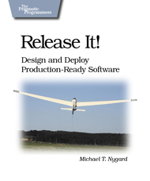




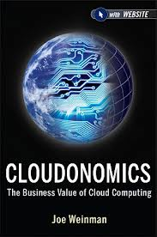
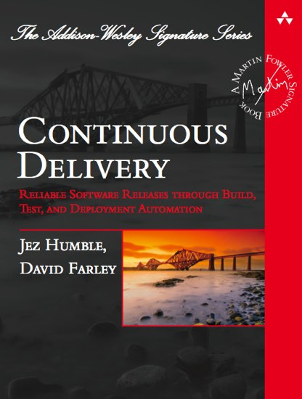

Inspiration
Notes:
See published article on Black Duck site.
Include Mark Burgess In Seach of Certainty and Jez Humble Lean Enterprise (coming soon).

Slide 31
How to get to Cloud Native
Freedom and Responsibility for Developers
Decentralize and Automate Ops Activities
Integrate DevOps into the Business Organization
Re-Org!
Notes:
There’s a big gap between typical enterprise practices and cloud native, so how do you get there?
The first step needs trust, you have to give freedom with responsibility to developers.
The next step needs automation, decentralize ops activities and give the developers the tools to do it themselves.
The resulting DevOps practices are no use until they are applied to business problems, so also closely integrate the DevOps role or even the whole team into the business organization.
For most companies that means a big re-org.
I gave this talk to a financial services company who went away to think about it, and came back six months later saying they had buy-in to do a re-org of their operations tools team into the development organization, and they wanted to talk about how we did the details of that. It can be done.

Slide 32
Four Transitions
Management: Integrated Roles in a Single Organization
Business, Development, Operations -> BusDevOps
Developers: Denormalized Data – NoSQL
Decentralized, scalable, available, polyglot
Responsibility from Ops to Dev: Continuous Delivery
Decentralized small daily production updates
Responsibility from Ops to Dev: Agile Infrastructure - Cloud
Hardware in minutes, provisioned directly by developers
Notes:
To summarize the transition to cloud native there are four transitions to work on.
First is the management one I just mentioned, re-organize to get as close as possible to integrated development and operations in the business. At Netflix this is a single “Product” organization, it owns the customer experience all the way to the AWS and pagerduty bills to run and operate the product.
Second is probably the single hardest part of the transition. Getting developers who have spent years being taught how to construct consistent normalized schemas to “let go” of transactions and deal with inconsistency directly in their code, Cope with de-normalized data stores. Build cross data store data consistency maintenance tasks. Understand what AP really means in the CAP theorem. In fact, as soon as your company has more than one data store with a foreign key in it, you already have these problems, but may be in denial about how to fix it when things go wrong. When done right, a de-normalized NoSQL AP system like Cassandra, Riak or DynamoDB is almost indestructible and repairs itself automatically. The quick way to tell a NoSQL system isn’t a highly available AP model is when you find it has a master somewhere in it’s architecture. Master-slave systems are more consistent and less available (CP). The quick way to tell a NoSQL vendor or their marketing department doesn’t understand CAP is if they try to tell you about their consistent and available (CA) system.
Third is to move responsibility from Ops to Dev for delivery. If a developer is pushing code to production every day, there isn’t time to have meetings with anyone from operations about it. Make them responsible for the current state of their own microservice.
Fourth is to provision hardware capacity directly by the developers, development systems created directly in minutes, test frameworks spun up automatically as needed and production preferably using autoscalers to dynamically create instances as needed to handle code pushes and scale.

Slide 33
The DIY Question
Why doesn’t Netflix build and run its own cloud?
Notes:
Questions that often get asked.

Slide 34
Fitting Into Public Scale
Public
Grey Area
Private
1,000 Instances
100,000 Instances
Startups
Netflix
Facebook
Notes:
If you are a startup with less than 1000 instances, you probably can’t afford enough people and time to run your own infrastructure.
If you are Facebook or Google with a huge footprint you have plenty of people and capability to run your own internal cloud-like operations.
In the middle is a grey area where you could go either way. Netflix with a few tens of thousands of instances is small enough to fit in a public cloud, as long as it’s AWS sized.
So how big is AWS, and how fast is it growing? We don’t officially know, but we have a useful clue.

Slide 35
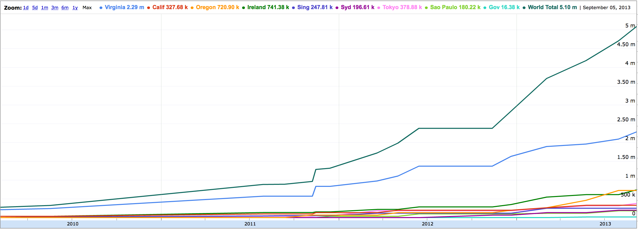
How big is Public?
AWS Maximum Possible Instance Count 5.1 Million – Sept 2013
Growth >10x in Three Years, >2x Per Annum - http://bit.ly/awsiprange
AWS upper bound estimate based on the number of public IP Addresses
Every provisioned instance gets a public IP by default (some VPC don’t)
Notes:
A few years ago I found a blog post that compared a few public data points extracted from a regularly updated blog post by AWS that discloses their IP address ranges. This is needed to whitelist and identify instances for security purposes. Other cloud vendors don’t seem to publish similar data so far.
When I first looked, there were about 500,000 IP addresses, three years later there were over 5 million. That’s 10x in three years and more than doubling each year.
Almost every instance that is created on AWS gets a public IP address assigned to it by default, whether it uses it or not. The IP address range acts as an upper bound limit on the maximum possible number of instances that AWS could deploy, although it would run out of physical hardware first. It is possible to create Virtual Private Cloud instances that don’t assign a public IP address, but this is a relatively uncommon case.
The other useful record shows the introduction dates and relative size of each of the AWS regions. I maintain the raw data and graph stored as a google doc with an easy to remember URL that is shown.

Slide 36
The Alternative Supplier Question
What if there is no clear leader for a feature, or AWS doesn’t have what we need?

Slide 37
Things We Don’t Use AWS For
SaaS Applications – Pagerduty, Onelogin etc.
Content Delivery Service
DNS Service
Notes:
There are several things that Netflix doesn’t use AWS for.
SaaS applications that are self contained and AWS has no equivalent of include Pagerduty (which runs using multiple AWS regions underneath); and OneLogin who provide fine grain SAML authentication across multiple SaaS services.
The Netflix CDN and DNS strategy will be discussed next.

Slide 38
CDN Scale
AWS CloudFront
Akamai
Limelight
Level 3
Netflix Openconnect
YouTube
Gigabits
Terabits
Startups
Facebook
Netflix
Notes:
If you are a startup and you want an easy to use low cost CDN integrated with everything else on AWS, CloudFront is a great choice. If you are a much bigger organization like Facebook generating a few percent of internet traffic most people use one of the three biggest “Terabit scale” vendors – Akamai, Limelight and Level 3.
Netflix and YouTube sharks are too big to fit into a public CDN paddling pool so they have deployed their own caches that are hosted at ISPs and at Internet peering points globally.
What does one of these look like?

Slide 39
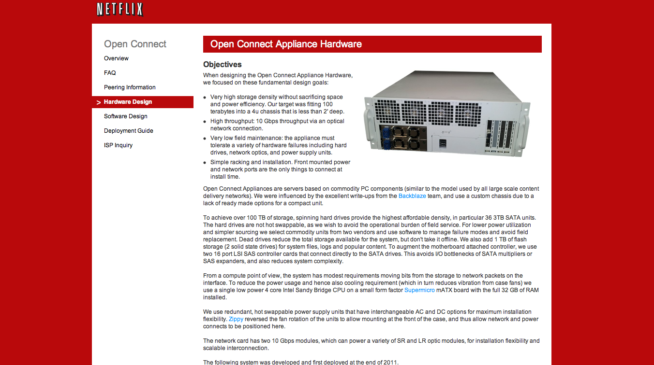
Content Delivery Service Open Source Hardware Design + FreeBSD, bird, nginx see openconnect.netflix.com
Notes:
Netflix built it’s own hardware. It’s given away free to ISP’s that have significant Netflix traffic, saves money for them, saves money for Netflix, and provides a better quality service for customers.
In countries where there is true choice and competition between ISPs almost all of them adopt the cache. In countries like the USA where there are local ISP monopolies it’s mainly the smaller ISP’s like Cablevision and Google Fiber that have adopted the caches so far.
To serve as an origin store and for customers that don’t have ISP caches, Netflix has large installations of these boxes located near primary internet peering sites around the world.
Go to openconnect.netflix.com for more information and see the Netflix Blog for data on the ISP speed index.

Slide 40
DNS Service
AWS Route53 is missing too many features (for now)
Multiple vendor strategy Dyn, Ultra, Route53
Abstracted (broken) DNS APIs with Denominator
Notes:
Domain Name Service (DNS) is also an area where Netflix doesn’t depend on AWS. The AWS Route53 service is excellent but is still missing several key features at the moment. A multiple vendor strategy was adopted to use the full features of the Dyn and UltraDNS products, with Route53 providing reliable automation and switching via it’s API. The Denominator library was built as an open source project to provide a common interface to all these vendors, although the underlying broken-ess of the Dyn and Ultra APIs makes them unreliable for automation.

Slide 41
What Changed?
Cost reduction
Slow down developers
Less competitive
Less revenue
Lower margins
Process reduction
Speed up developers
More competitive
More revenue
Higher margins
Get out of the way of innovation
Best of breed, by the hour
Choices based on scale
Notes:
What changed in the move to Cloud Native?
Get out of the way of innovation to move faster and be more competitive.
On the left is the operations oriented cycle that starts with cost savings, those have the side effect of slowing down developers, which makes the organization less competitive, that leads to less revenue and lower margins, which requires more cost reduction. This is the death spiral that many large organizations find themselves in.
The alternative on the right is how many startups operate and what Netflix strives for. Starting with process reduction, simplifying products and removing sign-off and coupling between teams and managers speeds up developers, that makes the product more competitive, which leads to more revenue, higher margins and no need for cost reduction. It’s incredibly hard to switch corporate culture from one to the other, but the first step is to understand the trends that will drag you into the death spiral and resist them.
The use of cloud based services lets you switch to the current best of breed, paying by the hour, avoiding the lock-in of having bought a product and being stuck with it for several years. When AWS comes out with new instance types that have lots of high speed SSD or the latest Ivy-bridge CPUs, just start using them. If you bought reservations for the older type, the dollar value can be switched between instance types.
Choosing whether to build your own service or use a shared public service is based on your scale vs. the public scale. If you fit, then the flexibility is worth it, if you have outgrown the public service in some important dimension, then you have to build your own cloud or service.

Slide 42
Getting to Cloud Native
Notes:
What’s the transition plan? Let’s keep it simple and start with a standalone service that could be one of many in an enterprise, or the initial deployment for a new-ish startup.

Slide 43
Congratulations, your startup got funding!
More developers
More customers
Higher availability
Global distribution
No time….
Notes:
Let’s say you have a great idea, you’ve demonstrated product-market fit, and you just closed a B-round to fund the sales expansion of your SaaS product. You get to hire more developers, you will have lots of customers, they will demand higher availability and will need you to have a global presence. Or maybe you are just hoping to get something like heathcare.gov built before the deadline…

Slide 44

Your architecture looks like this:
AWS Zone A
Web UI / Front End API
Middle Tier
RDS/MySQL
Notes:
Your starting point is your current architecture, you used a rapid prototyping wed UI front end like Ruby on Rails, or Drupal, you may have a middle tier service or two that runs business logic or integrates with some other services, and a MySQL based back end. It’s all running on a handful of instances in a single AWS zone, and it has a few customers using it.

Slide 45
And it needs to look more like this…
Regional Load Balancers
Regional Load Balancers
Zone A
Cassandra Replicas
Zone B
Cassandra Replicas
Zone C
Cassandra Replicas
Zone A
Cassandra Replicas
Zone B
Cassandra Replicas
Zone C
Cassandra Replicas
Notes:
However you need it to look more like this.
Lots more customers, spread over lots of geographic regions, being routed to regional load balancers for fast local service and for high availability in case of disasters. Behind that, triple replicated micro-services running in three AWS availability zones per region, capable of operatingwithout a hiccup when a zone or a service has an issue caused by your own bad code or a cloud failure. Data replicated globally using the Cassandra NoSQL datastore, and perhaps using Riak or DynamoDB within a region.
This architecture is anti-fragile, self healing, supports continuous delivery, automated developer driven deployments and can be scaled in minutes to handle bursts in traffic.

Slide 46
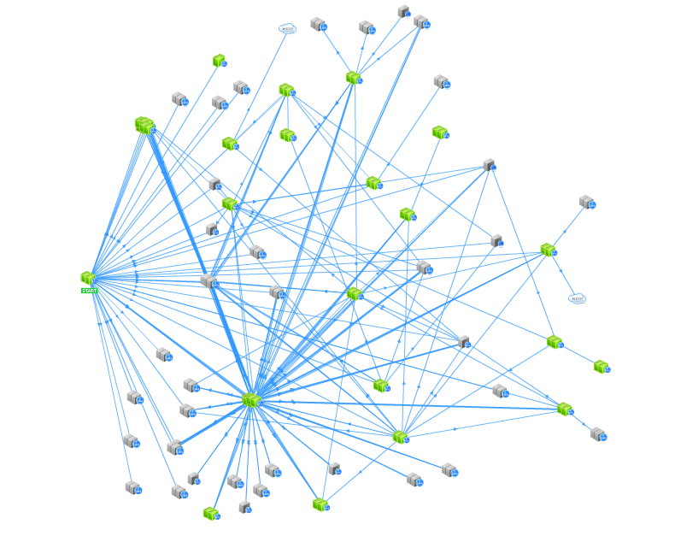
Inside each AWS zone: Micro-services and de-normalized data stores
memcached
Cassandra
API or Web Calls
Web service
S3 bucket
Notes:
Looking into each zone, we see lots of single function micro services and de-normalized data stores. This lets a larger team of developers innovate and deliver at their own pace without imposing the unnecessary coordination of a single monolithic build step or shared data schema.

Slide 47

We’re here to help you get to global scale…
Apache Licensed Cloud Native OSS Platform
http://netflix.github.com
Notes:
That’s a huge gap to bridge, but helpfully, most of the components and tools you need to make the transition are available as free open source packages, and in particular, Netflix now has over forty projects on Github that form a flexible cloud native open source platform. Many companies have already adopted various parts of the platform, so we’ll look at how to get started next.

Slide 48
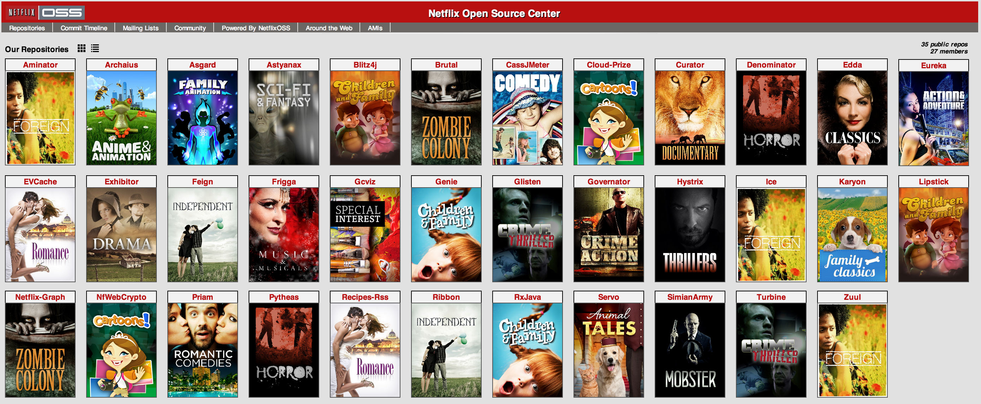
Technical Indigestion – what do all these do?
Notes:
During 2012 and 2013 Netflix released over forty projects to github, mostly with obscure names and unhelpful images. It got a bit confusing. The Netflix tech blog contains articles that explain why and how these projects were created, but how many people have time to read one or two detailed blog posts a week? This has lead to the problem we call “technical indigestion”. The inability to figure out that something useful already exists.

Slide 49
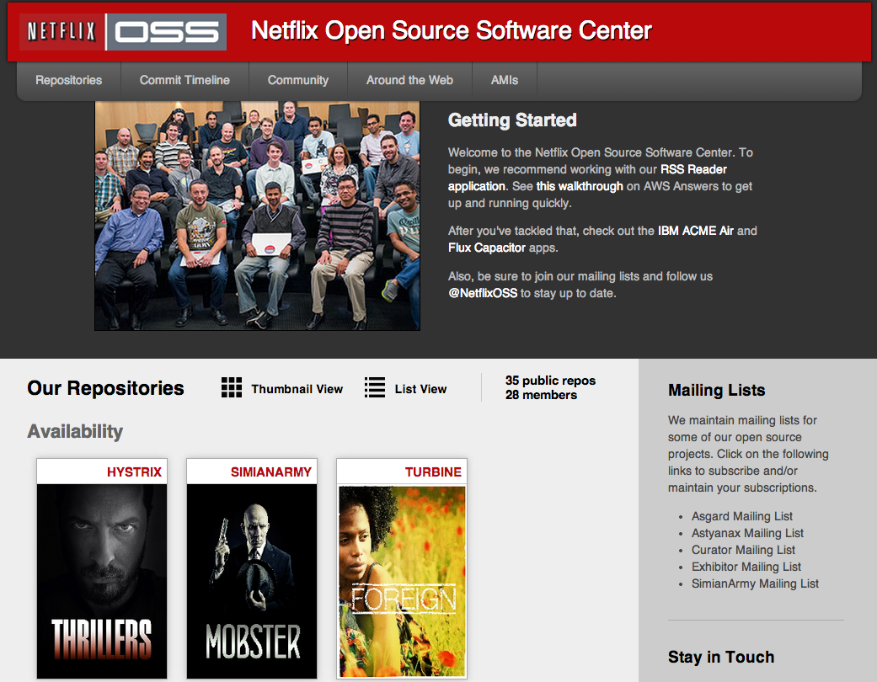
Updated site – make it easier to find what you need
Notes:
Late in 2013 Netflix re-organized the blog to make it easier to navigate, and added some getting started guides. The next section runs through them.

Slide 50
Getting started with NetflixOSS Step by Step
Set up AWS Accounts to get the foundation in place
Security and access management setup
Account Management: Asgard to deploy & Ice for cost monitoring
Build Tools: Aminator to automate baking AMIs
Service Registry and Searchable Account History: Eureka & Edda
Configuration Management: Archaius dynamic property system
Data storage: Cassandra, Astyanax, Priam, EVCache
Dynamic traffic routing: Denominator, Zuul, Ribbon, Karyon
Availability: Simian Army (Chaos Monkey), Hystrix, Turbine
Developer productivity: Blitz4J, GCViz, Pytheas, RxJava
Big Data: Genie for Hadoop PaaS, Lipstick visualizer for Pig
Sample Apps to get started: RSS Reader, ACME Air, FluxCapacitor
Notes:
Here’s the step by step guide as an overview, we’ll look at each of these in turn next.

Slide 51
AWS Account Setup
Notes:
It’s important to start with a defined set of accounts, rather than everything in one account, or every developer having their own. The structure used by Netflix is described here so you can understand some of the reasons and tradeoffs, but there are many other ways to set things up.

Slide 52
Flow of Code and Data Between AWS Accounts
Production
Account
Archive Account
Auditable
Account
Dev Test Build Account
Backup Data to S3
AMI
Weekend
S3 restore
New Code
AMI
Backup Data to S3
Notes:
The Netflix approach is to have a single build system pipeline, it’s used during development and test to deliver code into a single AWS account. Once the code for a new microservice is tested, the AMI for that microservice is migrated to an autoscale group in the production account. There are no cfengine, puppet, chef or whatever driven configuration changes happening in production, so this is sometimes called the “immutable server pattern”. The build pipeline can use chef recipes to create the initial AMI in test.
There is usually a need for extra audits for some services, for things like SOX or PCI compliance. The denormalized microservice architecture is used to minimize and separate the minimal set of sensitive code and data sources to a separate account shown below. Again the code is migrated via AMIs from the test account.
Backups of data sources are provided by making copies to S3 within each account. In addition an archive is maintained in a separate account with periodic copies from production accounts. The archive account doesn’t need any code to be deployed to it, since it just manages the S3 bucket lifecycle.
Buckets have read and write but no delete access from production, they are versioned to prevent overwriting data, and they auto-delete old files after a few months or whatever retention is desired. To ensure that backups are being performed correctly, every weekend the archive files are restored to the test account, which both validates the bbackup and keeps the test account data sources in a reasonably consistent state.
Netflix started out using the EC2-classic mechanisms in each account, and has found it hard to find a clean migration path to the newer VPC mechanism. If you are starting from scratch, start out with VPC everywhere, even if you don’t need its features to start with.

Slide 53
Account Security
Protect Accounts
Two factor authentication for primary login
Delegated Minimum Privilege
Create IAM roles for everything
Security Groups
Control who can call your services
Notes:
Security is one of those things that you have to get right first and resist temptations to make shortcuts. It’s very hard to add more security into a running architecture, so establish it in the baseline patterns and tooling from the start.
A small number of key people should be trusted to create new accounts, and they should use 2FA with the AWS console for setting up the patterns and privilege levels. The first thing to do is create delegated minimum roles that can’t do things like delete the account and those roles are used by the tooling that everyone else depends upon.
In a fine grain microservice architecture, you can either create one big security group for everyone to use and abuse, or setup a group for every individual service. It’s an extra step that is a minor pain each time a new service type is created, but it’s worth having the fine grain control that individual security groups give you. Each service can tell who can call it, and who could not.

Slide 54
Cloud Access Control
Cloud access audit log ssh/sudo bastion
www-prod
Userid wwwprod
Dal-prod
Userid dalprod
Cass-prod
Userid cassprod
Developers
Security groups don’t allow
ssh between instances

Slide 55
Tooling and Infrastructure

Slide 56
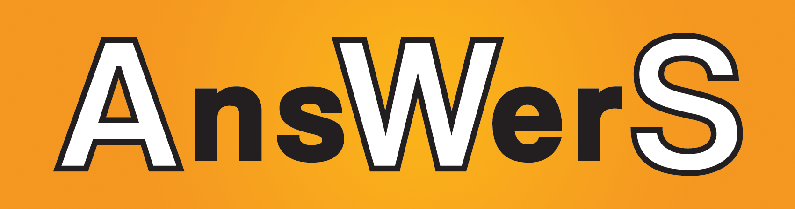
Fast Start Amazon Machine Images
https://github.com/Answers4AWS/netflixoss-ansible/wiki/AMIs-for-NetflixOSS
Pre-built AMIs for
Asgard – developer self service deployment console
Aminator – build system to bake code onto AMIs
Edda – historical configuration database
Eureka – service registry
Simian Army – Janitor Monkey, Chaos Monkey, Conformity Monkey
NetflixOSS Cloud Prize Winner
Produced by Answers4aws – Peter Sankauskas

Slide 57
Fast Setup CloudFormation Templates
http://answersforaws.com/resources/netflixoss/cloudformation/
CloudFormation templates for
Asgard – developer self service deployment console
Aminator – build system to bake code onto AMIs
Edda – historical configuration database
Eureka – service registry
Simian Army – Janitor Monkey for cleanup,

Slide 58
CloudFormation Walk-Through for Asgard
(Repeat for Prod, Test and Audit Accounts)

Slide 59
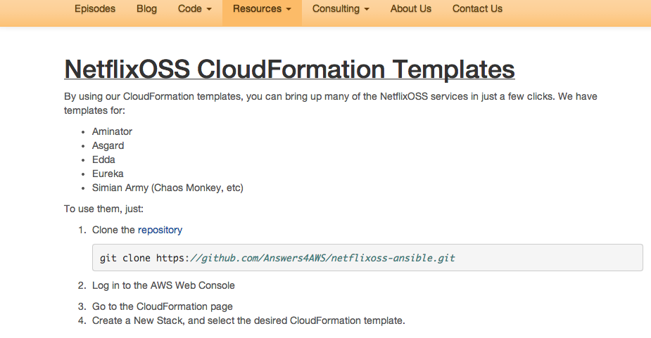

Slide 60
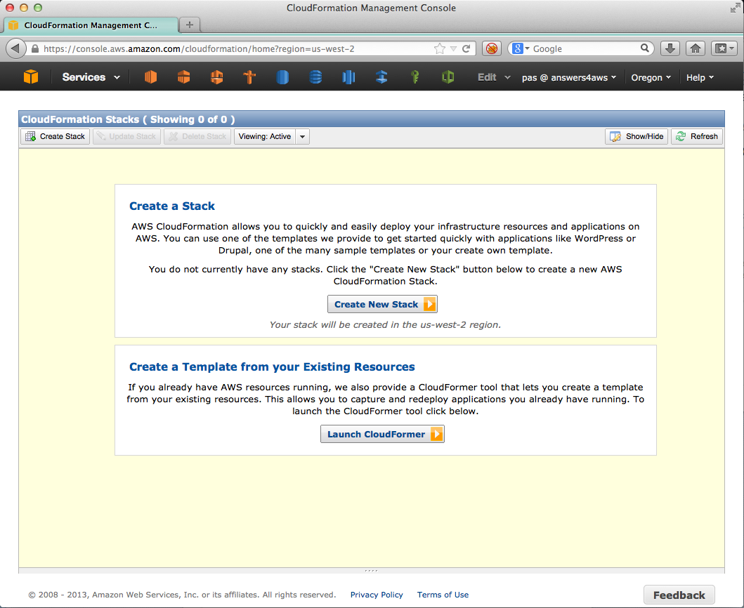
Setting up Asgard – Step 1 Create New Stack

Slide 61
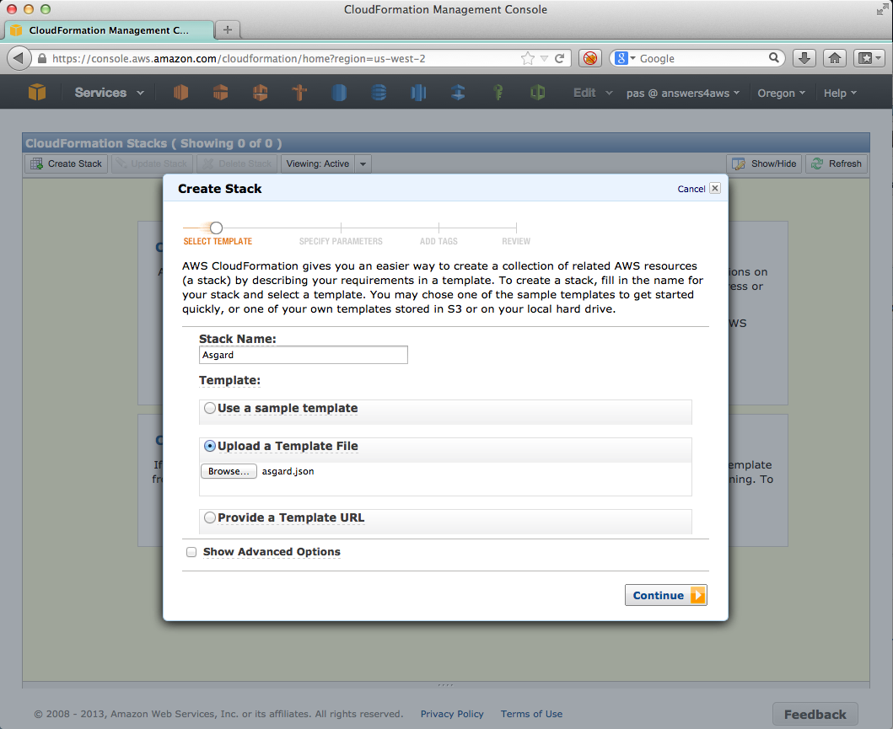
Setting up Asgard – Step 2 Select Template

Slide 62
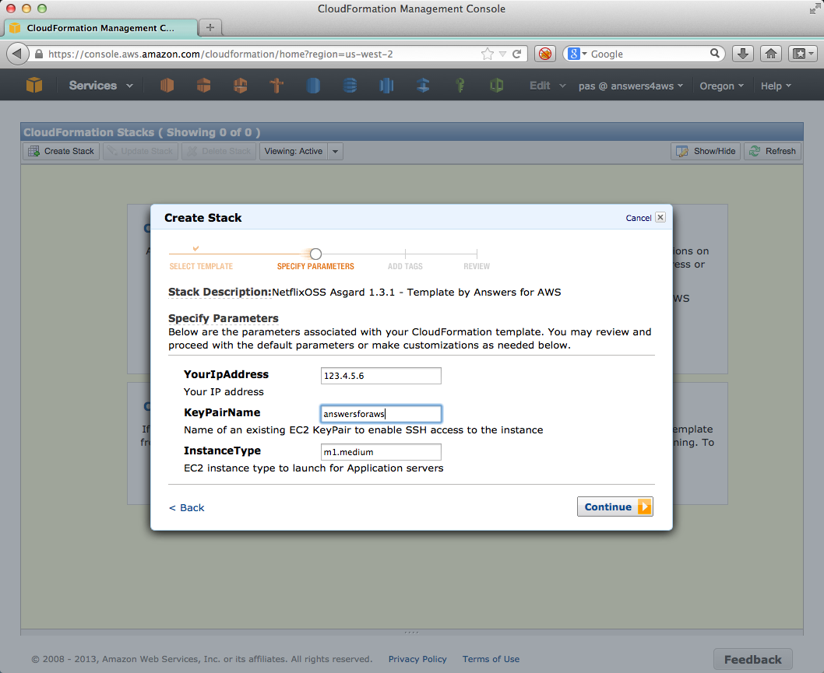
Setting up Asgard – Step 3 Enter IP & Keys

Slide 63
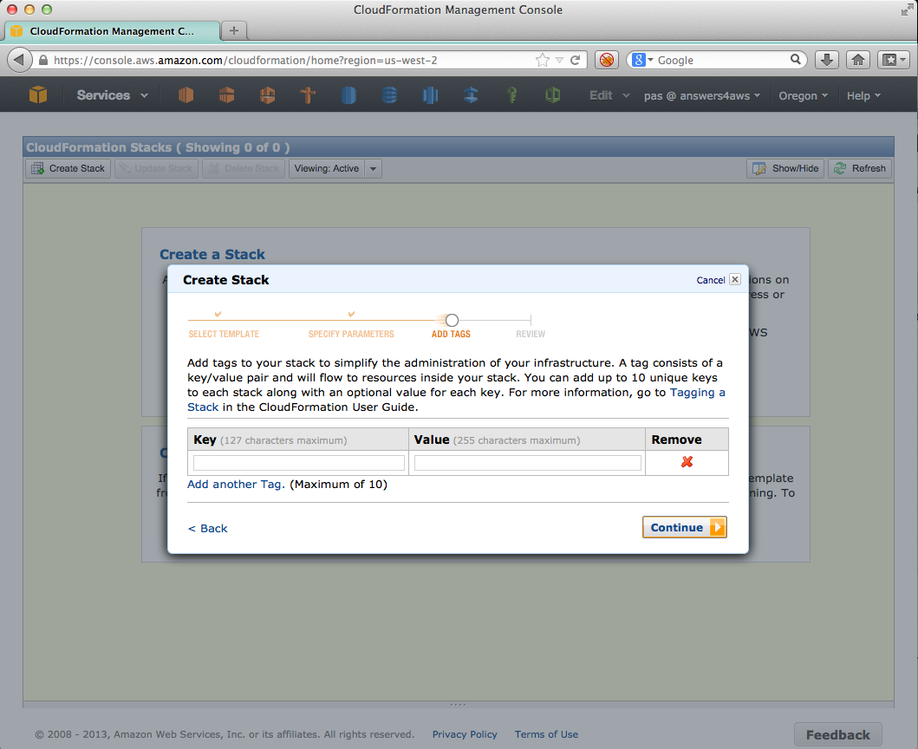
Setting up Asgard – Step 4 Skip Tags

Slide 64
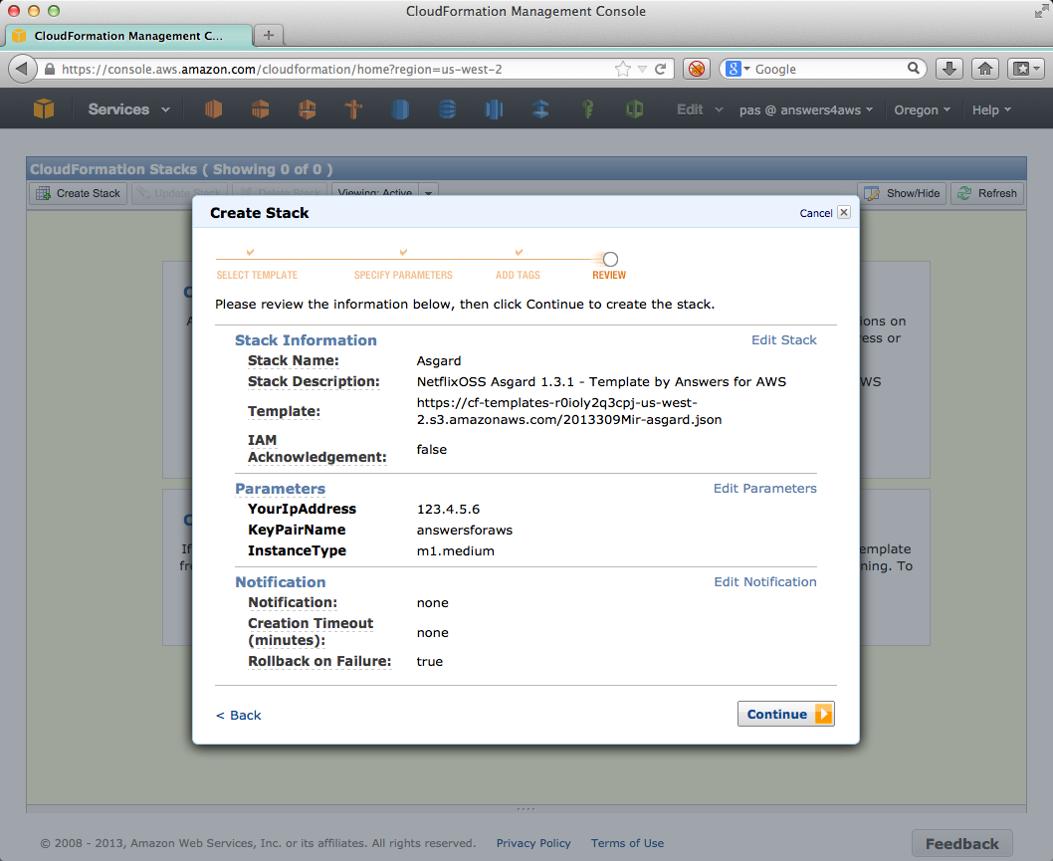
Setting up Asgard – Step 5 Confirm

Slide 65
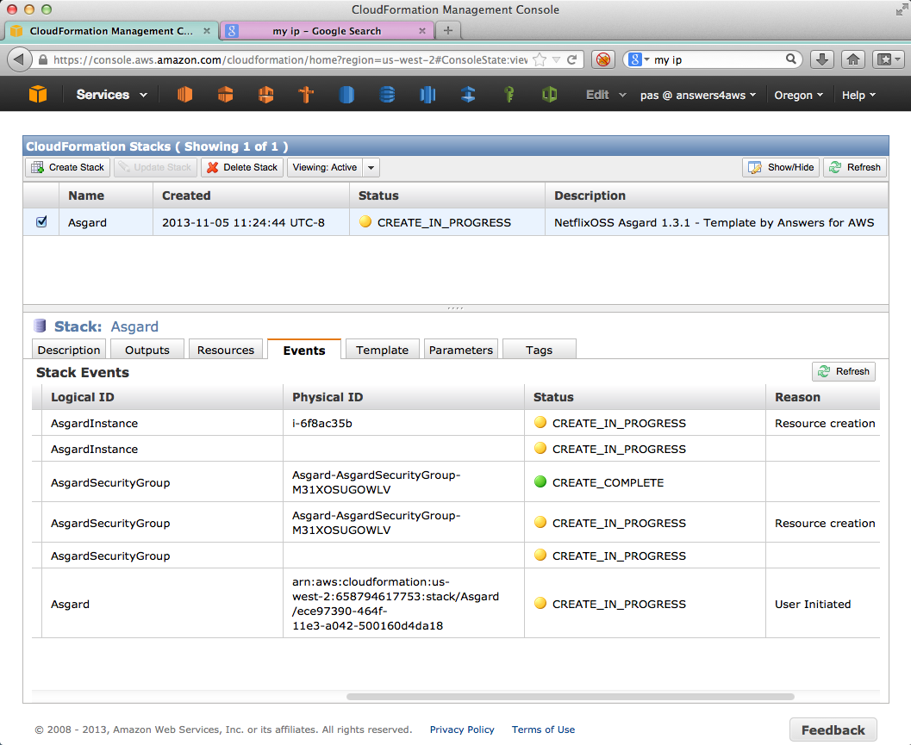
Setting up Asgard – Step 6 Watch CloudFormation

Slide 66
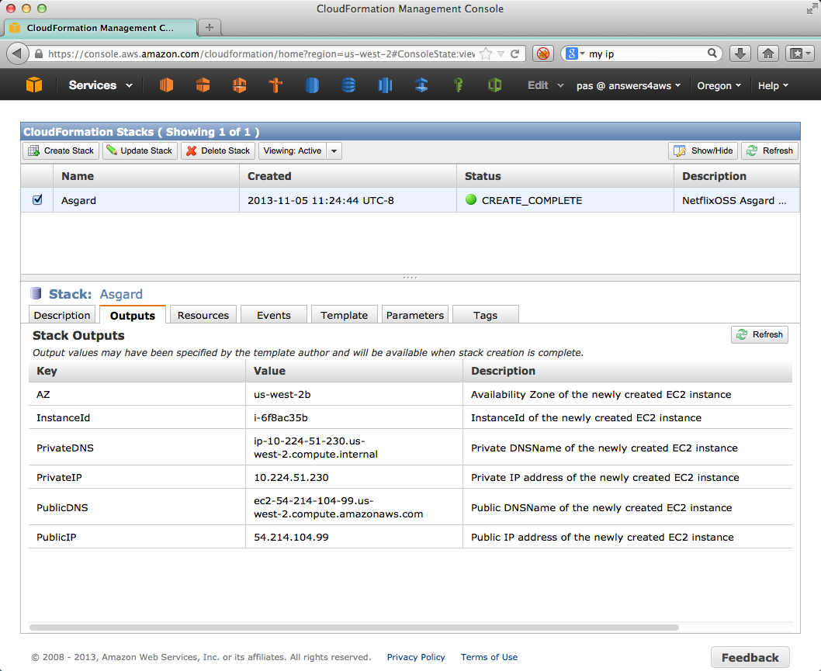
Setting up Asgard – Step 7 Find PublicDNS Name

Slide 67
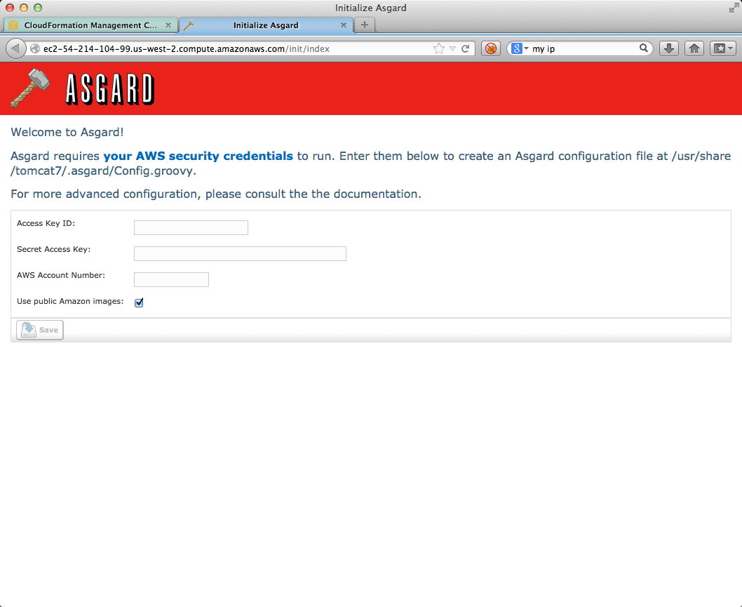
Open Asgard – Step 8 Enter Credentials

Slide 68
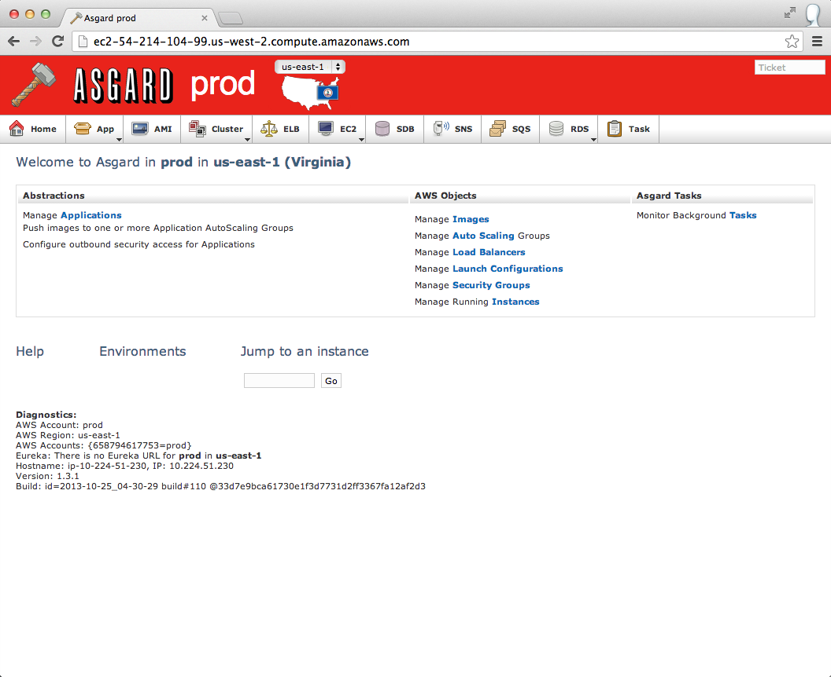
Use Asgard – AWS Self Service Portal

Slide 69
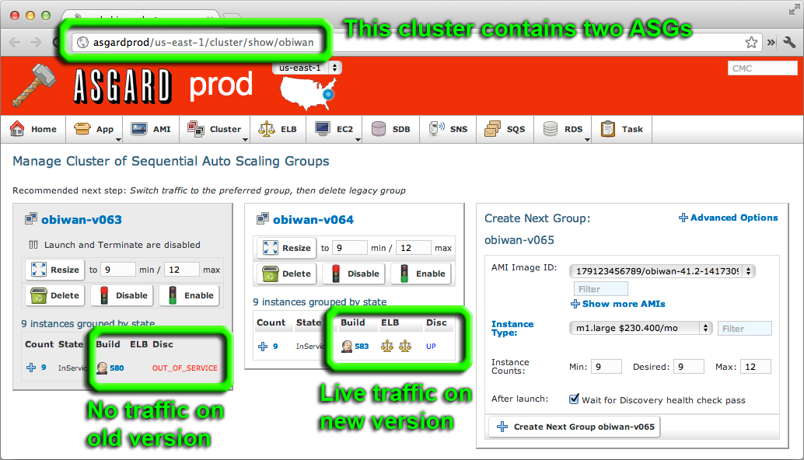
Use Asgard - Manage Red/Black Deployments

Slide 70
Track AWS Spend in Detail with ICE

Slide 71
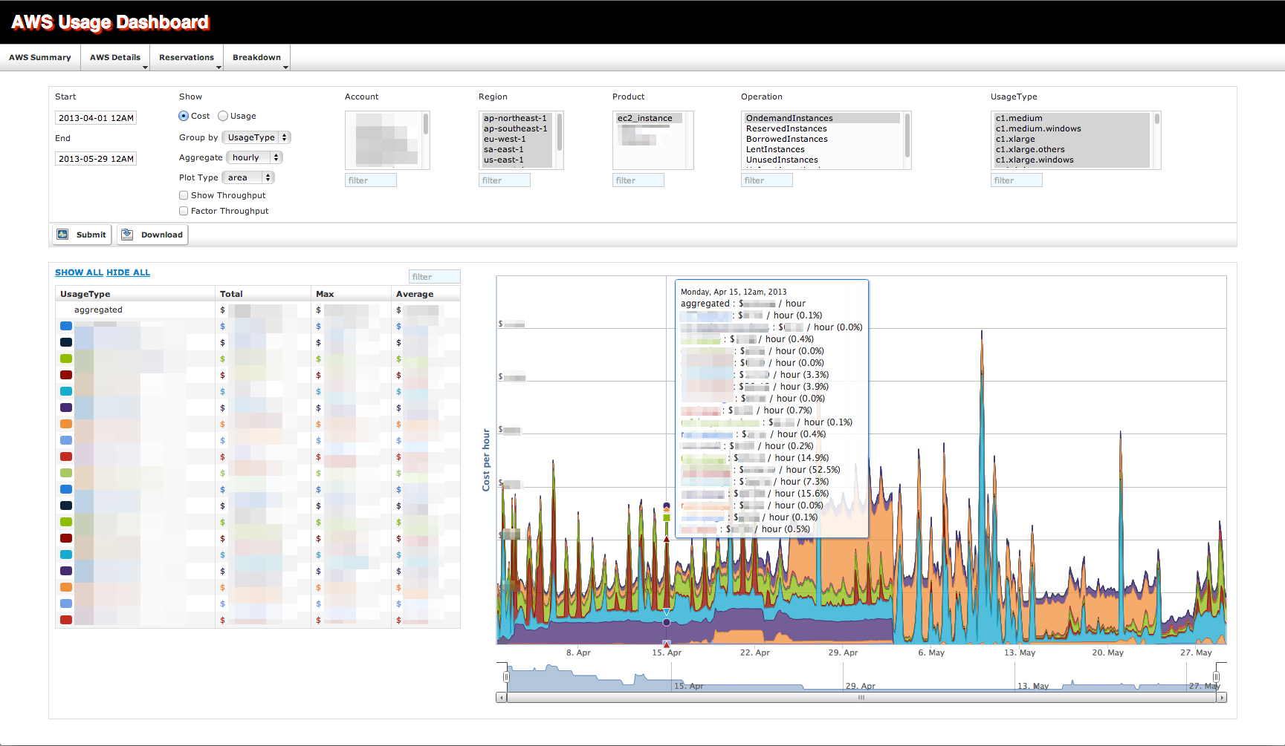
Ice – Slice and dice detailed costs and usage

Slide 72
Setting up ICE
Visit github site for instructions
Currently depends on HiCharts
Non-open source package license
Free for non-commercial use
Download and license your own copy
We can’t provide a pre-built AMI – sorry!
Long term plan to make ICE fully OSS
Anyone want to help?

Slide 73
Build Pipeline Automation
Jenkins in the Cloud auto-builds NetflixOSS Pull Requests http://www.cloudbees.com/jenkins

Slide 74
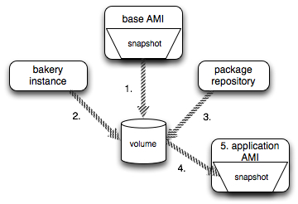
Automatically Baking AMIs with Aminator
AutoScaleGroup instances should be identical
Base plus code/config
Immutable instances
Works for 1 or 1000…
Aminator Launch
Use Asgard to start AMI or
CloudFormation Recipe

Slide 75
Discovering your Services - Eureka
Map applications by name to
AMI, instances, Zones
IP addresses, URLs, ports
Keep track of healthy, unhealthy and initializing instances
Eureka Launch
Use Asgard to launch AMI or use CloudFormation Template

Slide 76
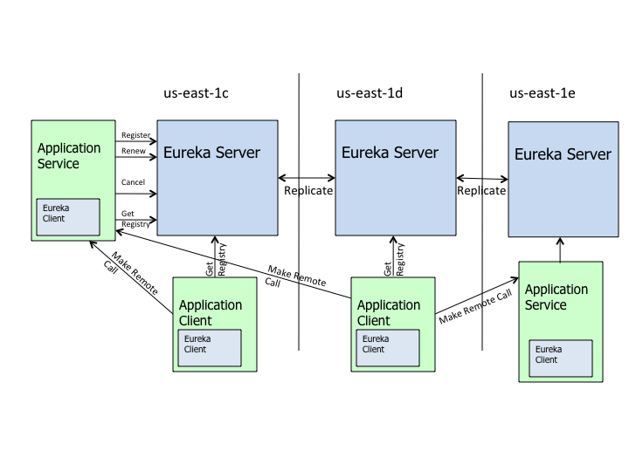
Deploying Eureka Service – 1 per Zone

Slide 77
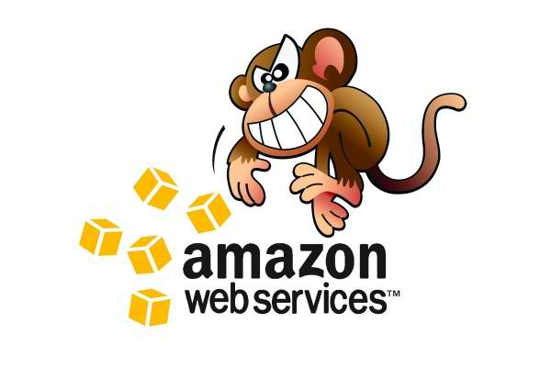
Searchable state history for a Region / Account
Edda Launch
Use Asgard to launch AMI or
use CloudFormation Template
Edda
AWS Instances, ASGs, etc.
Eureka Services metadata
Your Own Custom State
Timestamped delta cache of JSON describe call results for anything of interest…
Monkeys

Slide 78
Edda Query Examples
Find any instances that have ever had a specific public IP address
$ curl "http://edda/api/v2/view/instances;publicIpAddress=1.2.3.4;_since=0"
["i-0123456789","i-012345678a","i-012345678b”]
Show the most recent change to a security group
$ curl "http://edda/api/v2/aws/securityGroups/sg-0123456789;_diff;_all;_limit=2"
--- /api/v2/aws.securityGroups/sg-0123456789;_pp;_at=1351040779810
+++ /api/v2/aws.securityGroups/sg-0123456789;_pp;_at=1351044093504
@@ -1,33 +1,33 @@
{
…
"ipRanges" : [
"10.10.1.1/32",
"10.10.1.2/32",
+ "10.10.1.3/32",
- "10.10.1.4/32"
…
}

Slide 79
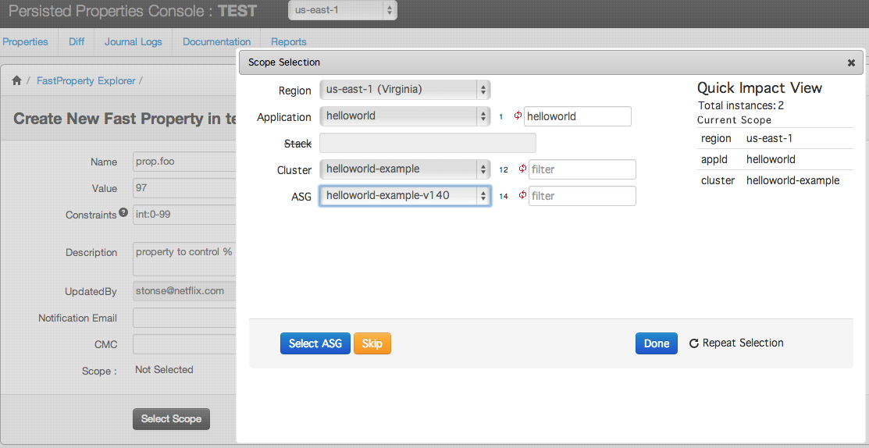
Archaius – Property Console

Slide 80
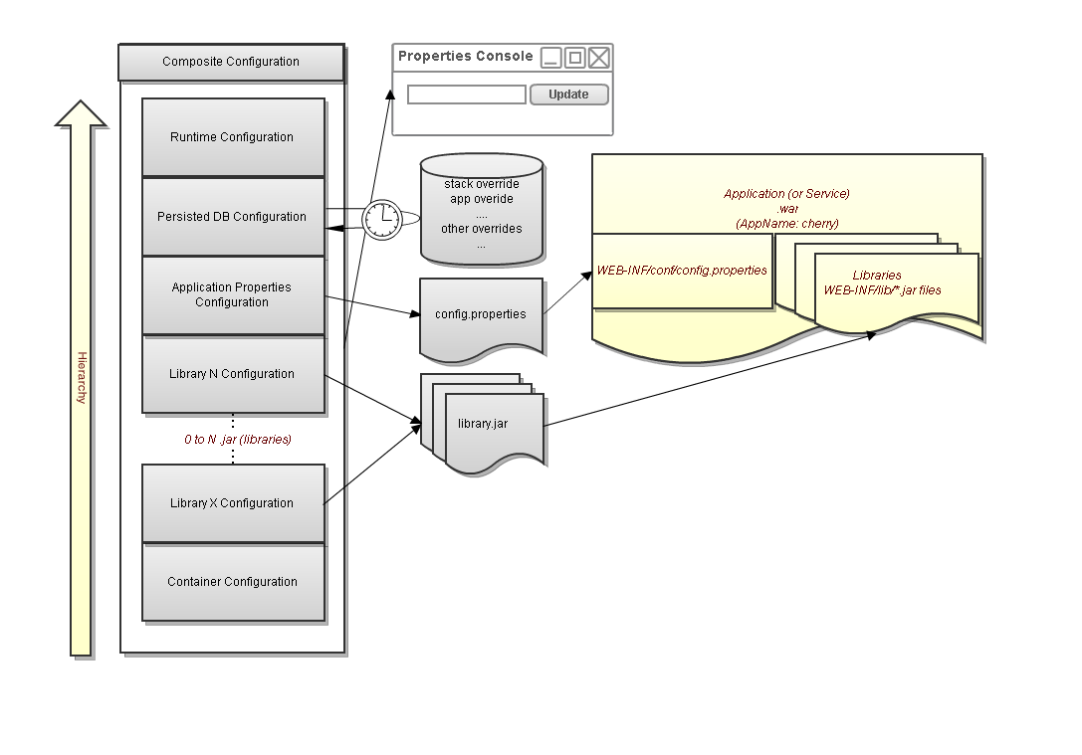
Archaius library – configuration management
Based on Pytheas. Not open sourced yet
SimpleDB or DynamoDB for NetflixOSS. Netflix uses Cassandra for multi-region…

Slide 81
Data Storage and Access

Slide 82
Data Storage Options
RDS for MySQL
Deploy using Asgard
DynamoDB
Fast, easy to setup and scales up from a very low cost base
Cassandra
Provides portability, multi-region support, very large scale
Storage model supports incremental/immutable backups
Priam: easy deploy automation for Cassandra on AWS

Slide 83
Priam – Cassandra co-process
Runs alongside Cassandra on each instance
Fully distributed, no central master coordination
S3 Based backup and recovery automation
Bootstrapping and automated token assignment.
Centralized configuration management
RESTful monitoring and metrics
Underlying config in SimpleDB
Netflix uses Cassandra “turtle” for Multi-region

Slide 84
Astyanax Cassandra Client for Java
Features
Abstraction of connection pool from RPC protocol
Fluent Style API
Operation retry with backoff
Token aware
Batch manager
Many useful recipes
Entity Mapper based on JPA annotations

Slide 85
Cassandra Astyanax Recipes
Distributed row lock (without needing zookeeper)
Multi-region row lock
Uniqueness constraint
Multi-row uniqueness constraint
Chunked and multi-threaded large file storage
Reverse index search
All rows query
Durable message queue
Contributed: High cardinality reverse index

Slide 86
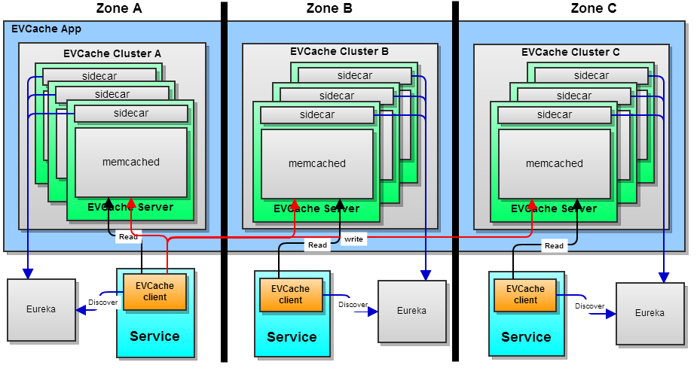
EVCache - Low latency data access
multi-AZ and multi-Region replication
Ephemeral data, session state (sort of)
Client code
Memcached

Slide 87
Routing Customers to Code

Slide 88
Denominator: DNS for Multi-Region Availability
UltraDNS
DynECT DNS
Denominator
AWS Route53
Zone A
Cassandra Replicas
Zone B
Cassandra Replicas
Zone C
Cassandra Replicas
Zone A
Cassandra Replicas
Zone B
Cassandra Replicas
Zone C
Cassandra Replicas
Regional Load Balancers
Regional Load Balancers
Zuul API Router
Denominator – manage traffic via multiple DNS providers with Java code

Slide 89
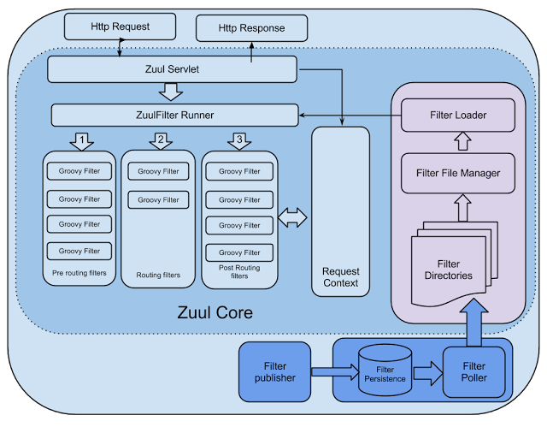
Zuul – Smart and Scalable Routing Layer
Notes:
Add link to CP benchmarks

Slide 90
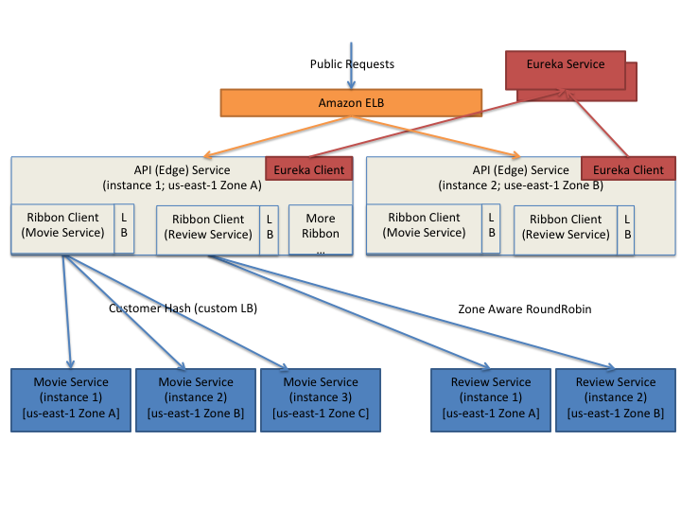
Ribbon library for internal request routing

Slide 91
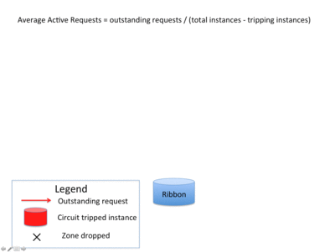
Ribbon – Zone Aware LB

Slide 92

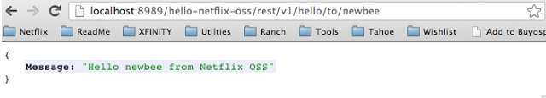
Karyon - Common server container
Bootstrapping
Dependency & Lifecycle management via Governator.
Service registry via Eureka.
Property management via Archaius
Hooks for Latency Monkey testing
Preconfigured status page and heathcheck servlets

Slide 93
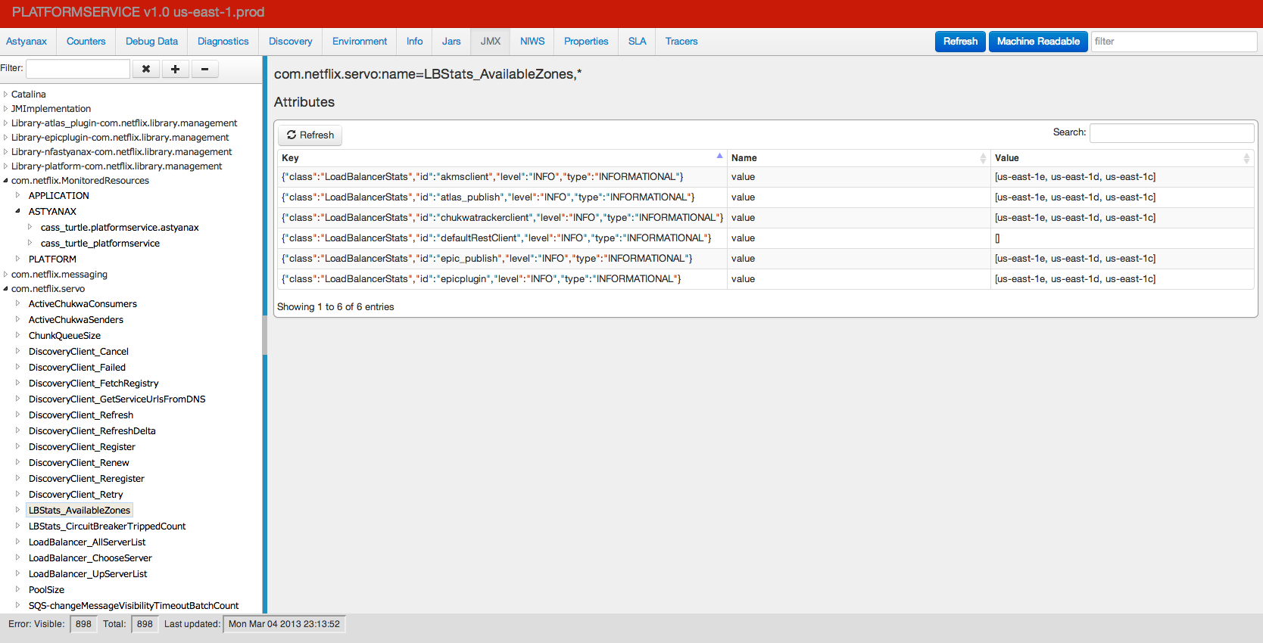
Karyon
Embedded Status Page Console
Environment
Eureka
JMX

Slide 94
Availability

Slide 95
Either you break it, or users will

Slide 96

Add some Chaos to your system

Slide 97

Clean up your room! – Janitor Monkey Works with Edda history to clean up after Asgard

Slide 98

Conformity Monkey Track and alert for old code versions and known issues Walks Karyon status pages found via Edda

Slide 99
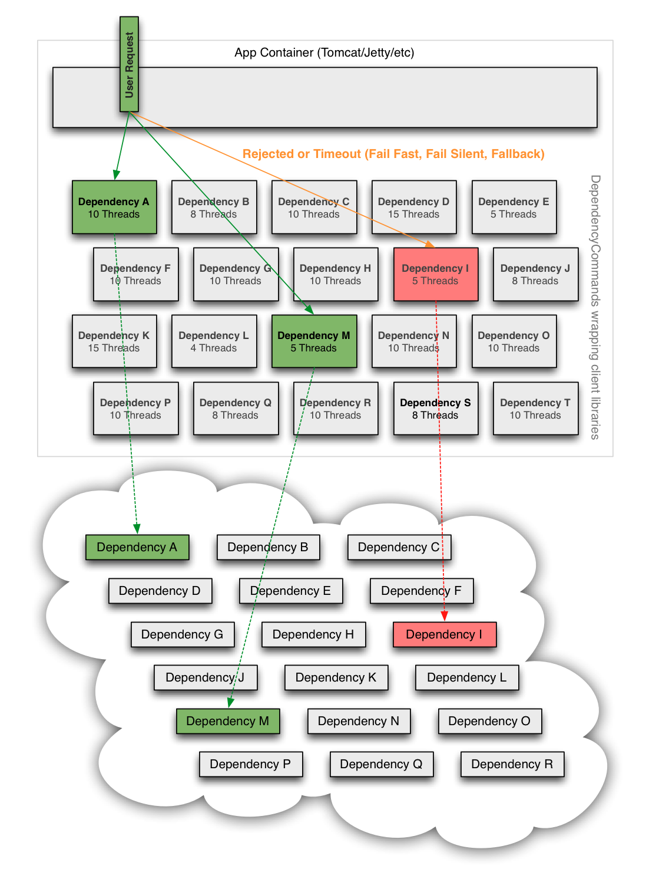
Hystrix Circuit Breaker: Fail Fast -> recover fast

Slide 100
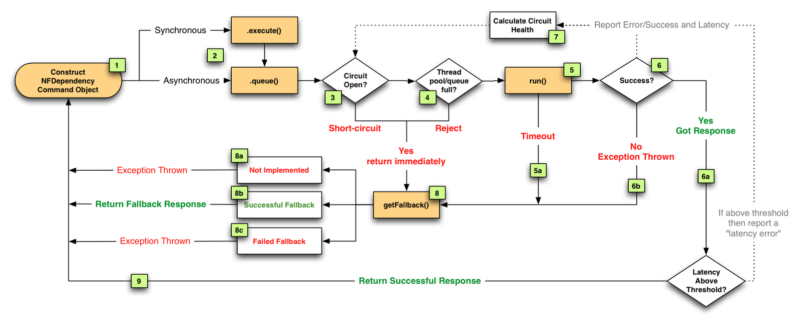
Hystrix Circuit Breaker State Flow

Slide 101
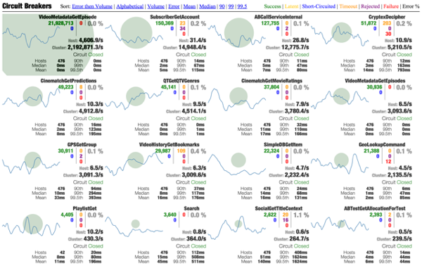
Turbine Dashboard Per Second Update Circuit Breakers in a Web Browser

Slide 102
Developer Productivity

Slide 103
Blitz4J – Non-blocking Logging
Better handling of log messages during storms
Replace sync with concurrent data structures.
Extreme configurability
Isolation of app threads from logging threads

Slide 104
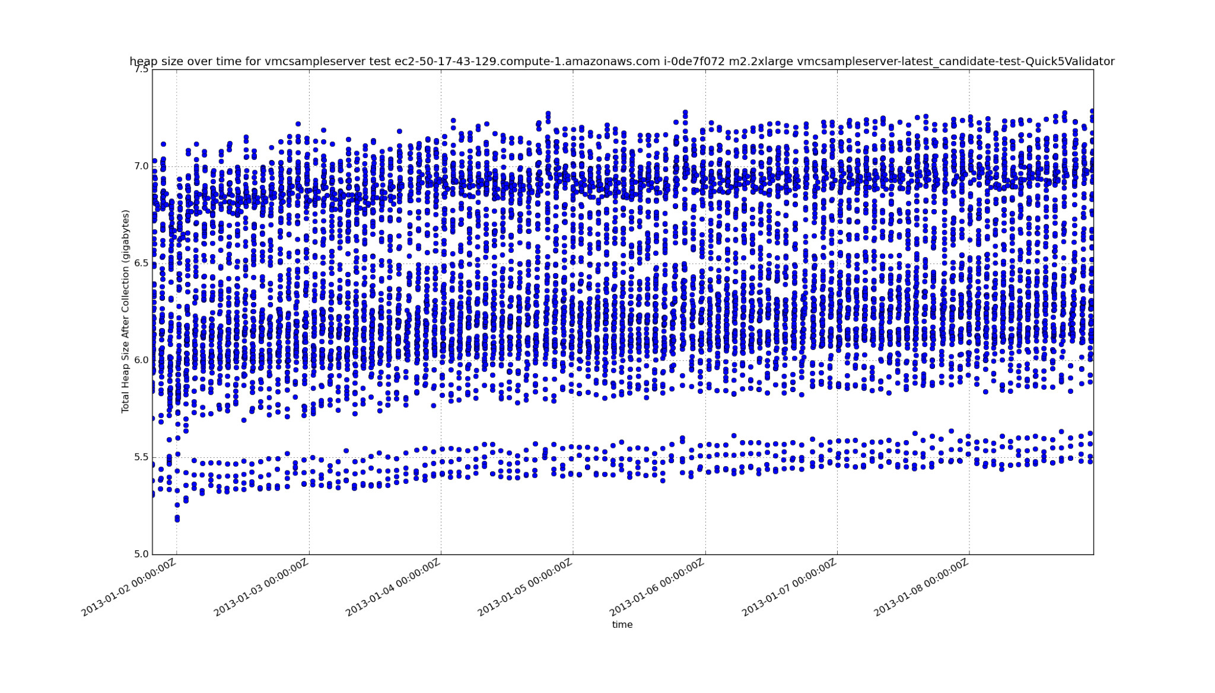
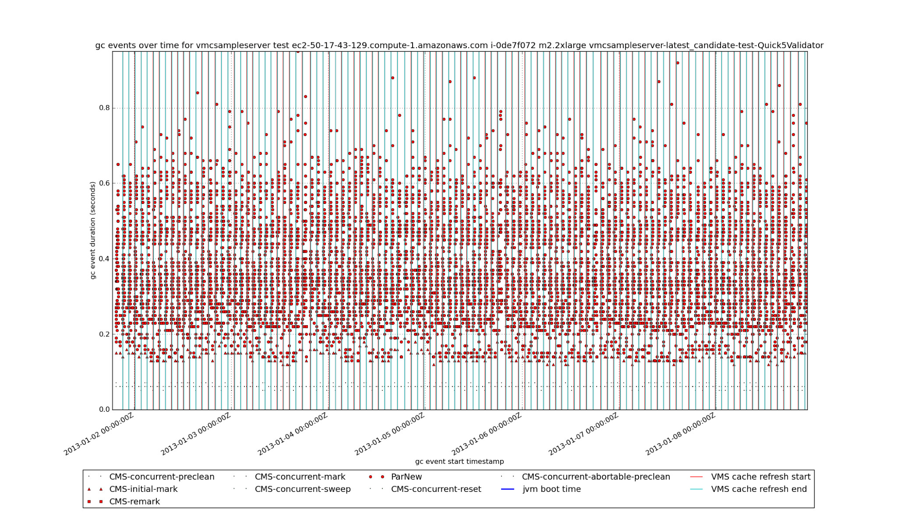
JVM Garbage Collection issues? GCViz!
Convenient
Visual
Causation
Clarity
Iterative

Slide 105
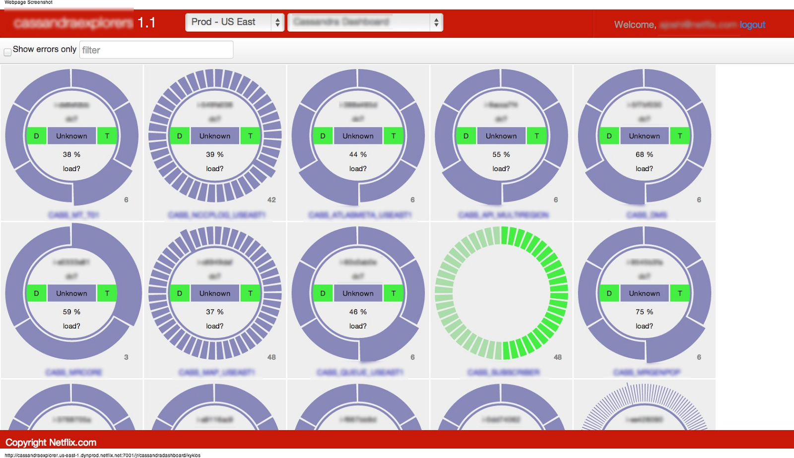
Pytheas – OSS based tooling framework
Guice
Jersey
FreeMarker
JQuery
DataTables
D3
JQuery-UI
Bootstrap

Slide 106
RxJava - Functional Reactive Programming
A Simpler Approach to Concurrency
Use Observable as a simple stable composable abstraction
Observable Service Layer enables any of
conditionally return immediately from a cache
block instead of using threads if resources are constrained
use multiple threads
use non-blocking IO
migrate an underlying implementation from network based to in-memory cache

Slide 107
Big Data and Analytics

Slide 108

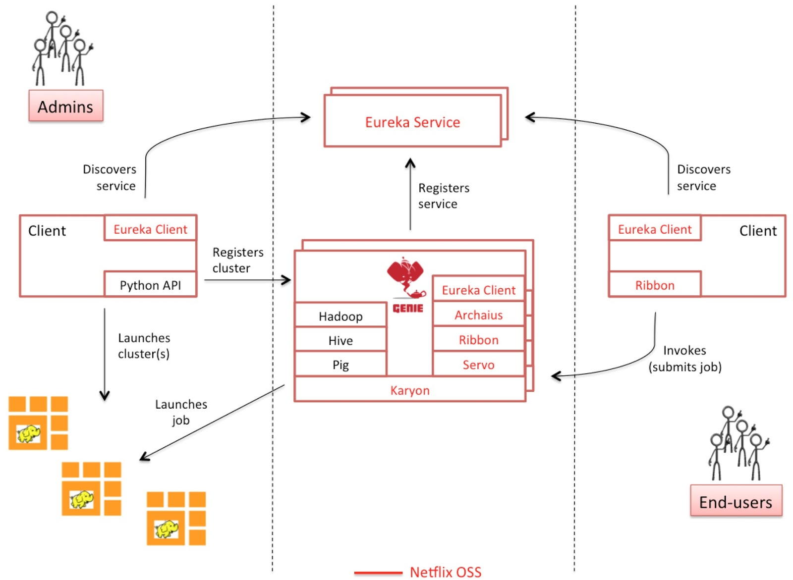
Hadoop jobs - Genie

Slide 109
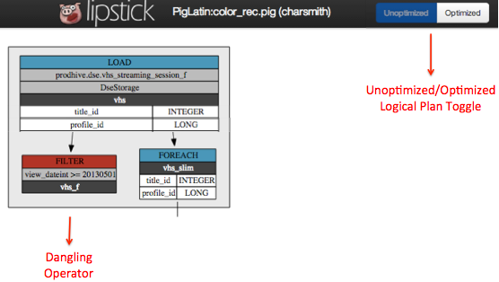

Lipstick - Visualization for Pig queries

Slide 110
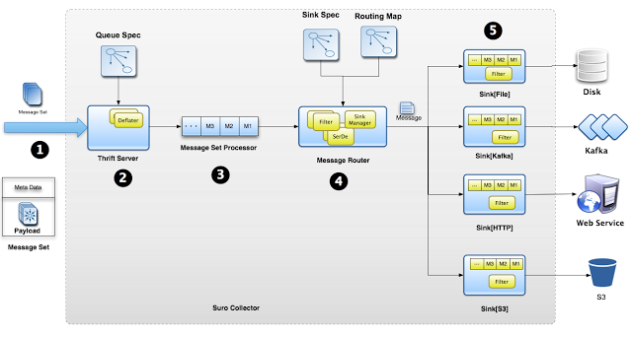
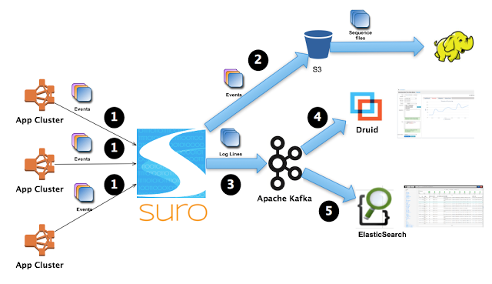
Suro Event Pipeline
Cloud native, dynamic,
configurable offline and
realtime data sinks
1.5 Million events/s
80 Billion events/day
Error rate alerting

Slide 111
Putting it all together…

Slide 112
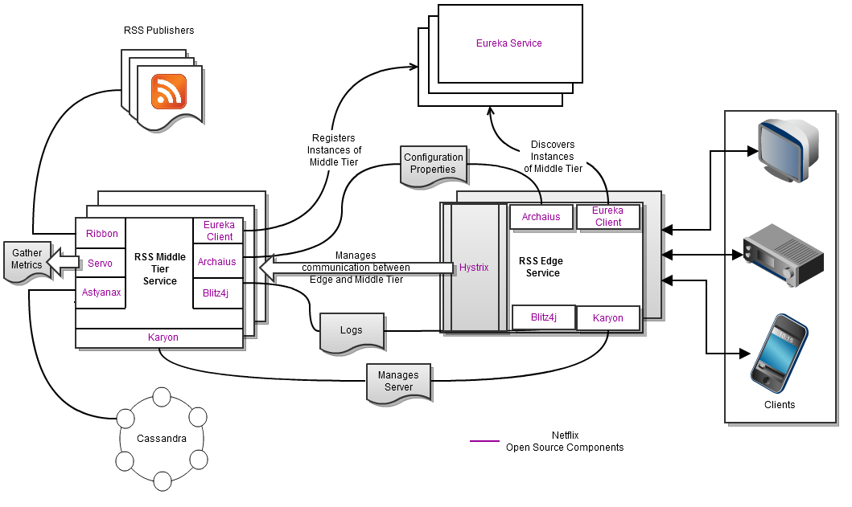
Sample Application – RSS Reader

Slide 113

3rd Party Sample App by Chris Fregly fluxcapacitor.com
Flux Capacitor is a Java-based reference app using:
archaius (zookeeper-based dynamic configuration)
astyanax (cassandra client)
blitz4j (asynchronous logging)
curator (zookeeper client)
eureka (discovery service)
exhibitor (zookeeper administration)
governator (guice-based DI extensions)
hystrix (circuit breaker)
karyon (common base web service)
ribbon (eureka-based REST client)
servo (metrics client)
turbine (metrics aggregation)
Flux also integrates popular open source tools such as Graphite, Jersey, Jetty, Netty, and Tomcat.

Slide 114
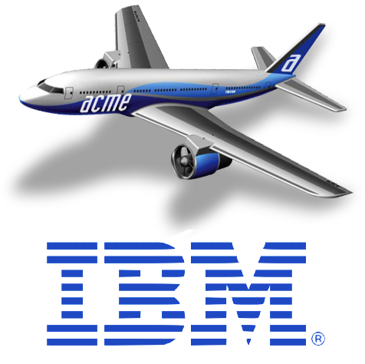
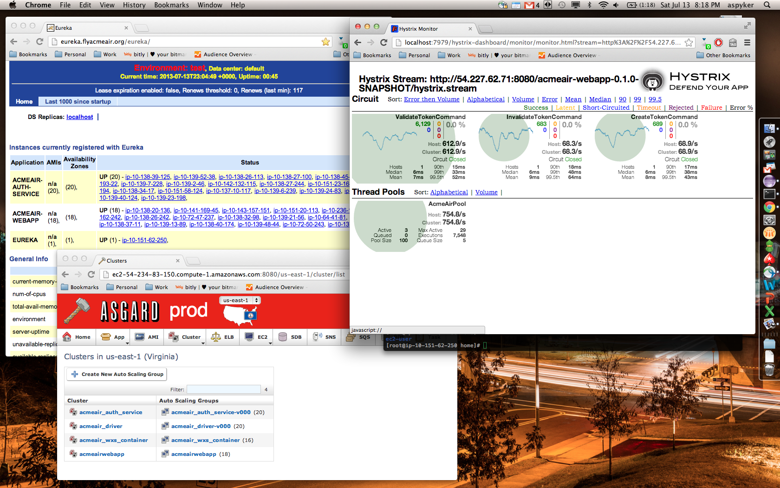
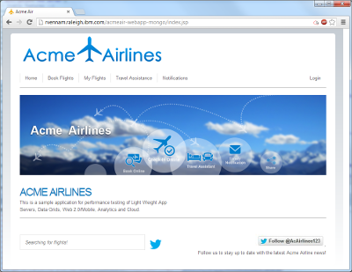
3rd party Sample App by IBM https://github.com/aspyker/acmeair-netflix/

Slide 115
NetflixOSS Project Categories

Slide 116
NetflixOSS Continuous Build and Deployment
Github
NetflixOSS
Source
Maven
Central
AWS
Base AMI
Cloudbees Jenkins
Aminator
Bakery
Dynaslave
AWS Build Slaves
AWS
Baked AMIs
Glisten
Workflow DSL
Asgard
(+ Frigga)
Console
AWS Account

Slide 117
NetflixOSS Services Scope
AWS Account
Asgard Console
Multiple AWS Regions
Eureka Registry
Exhibitor
Zookeeper
3 AWS Zones
Evcache
Memcached
Ephemeral Storage
Cross region Priam C*
Edda History
Simian Army
Archaius
Config Service
Pytheas
Dashboards
Atlas
Monitoring
Application Clusters
Autoscale Groups
Instances
Priam
Cassandra
Persistent Storage
Genie, Lipstick
Hadoop Services
Ice – AWS Usage
Cost Monitoring
Zuul Traffic Mgr

Slide 118
NetflixOSS Instance Libraries
Service Requests
Hystrix/Turbine – dependencies and real-time status
Ribbon and Feign - REST Clients for outbound calls
Logging
Blitz4j – non-blocking logging
Initialization
Governator – Guice based dependency injection
Archaius – dynamic configuration properties client
Servo – metrics export for autoscaling
Karyon - Base Server for inbound requests
RxJava – Reactive pattern
Atlas – high volume instrumentation
Baked AMI – Tomcat, Apache, your code
Eureka - service registration client
Data Access
Astyanax – Cassandra client and pattern library
Evcache – Zone aware Memcached client
Curator – Zookeeper patterns
Denominator – DNS routing abstraction

Slide 119
NetflixOSS Testing and Automation
Test Tools
CassJmeter – Load testing for Cassandra
Availability
Chaos Monkey – Kills Instances
Security
Security Monkey – security group and S3 bucket permissions
Latency Monkey – Latency and error injection
Maintenance
Janitor Monkey – Cleans up unused resources
Efficiency Monkey
Chaos Gorilla – Kills Availability Zones
Doctor Monkey
Circus Monkey – Test account reservation rebalancing
Howler Monkey – Complains about AWS limits
Chaos Kong – Kills Regions
Conformity Monkey – architectural pattern warnings

Slide 120

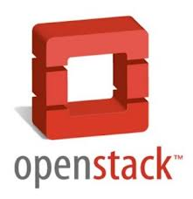

Vendor Driven Portability Interest in using NetflixOSS for Enterprise Private Clouds
“It’s done when it runs Asgard”
Functionally complete
Demonstrated March 2013
Released June 2013 in V3.3
Vendor and end user interest
Openstack “Heat” getting there
Paypal C3 Console based on Asgard
IBM Example application “Acme Air”
Based on NetflixOSS running on AWS
Ported to IBM Softlayer with Rightscale

Slide 121

Some of the companies using NetflixOSS (There are many more, please send us your logo!)

Slide 122
Use NetflixOSS to scale your startup or enterprise Contribute to existing github projects and add your own

Slide 123
Resilient API Patterns
Switch to Ben’s Slides

Slide 124
Availability
Is it running yet?
How many places is it running in?
How far apart are those places?

Slide 126
Netflix Outages
Running very fast with scissors
Mostly self inflicted – bugs, mistakes from pace of change
Some caused by AWS bugs and mistakes
Incident Life-cycle Management by Platform Team
No runbooks, no operational changes by the SREs
Tools to identify what broke and call the right developer
Next step is multi-region active/active
Investigating and building in stages during 2013
Could have prevented some of our 2012 outages

Slide 127
Incidents – Impact and Mitigation
Y incidents mitigated by Active Active, game day practicing
Public Relations Media Impact
PR
X Incidents
CS
XX Incidents
Metrics impact – Feature disable
XXX Incidents
No Impact – fast retry or automated failover
XXXX Incidents
YY incidents mitigated by better tools and practices
High Customer Service Calls
Affects AB Test Results
YYY incidents mitigated by better data tagging

Slide 128
Real Web Server Dependencies Flow (Netflix Home page business transaction as seen by AppDynamics)
Each icon is three to a few hundred instances across three AWS zones
Cassandra
memcached
Web service
Start Here
S3 bucket
Personalization movie group choosers (for US, Canada and Latam)

Slide 129
Three Balanced Availability Zones Test with Chaos Gorilla
Load Balancers
Zone A
Cassandra and Evcache Replicas
Zone B
Cassandra and Evcache Replicas
Zone C
Cassandra and Evcache Replicas
Chaos Gorilla

Slide 130
Isolated Regions
Zone A
Cassandra Replicas
Zone B
Cassandra Replicas
Zone C
Cassandra Replicas
EU-West Load Balancers
US-East Load Balancers
Zone A
Cassandra Replicas
Zone B
Cassandra Replicas
Zone C
Cassandra Replicas

Slide 131
Highly Available NoSQL Storage
A highly scalable, available and durable deployment pattern based on Apache Cassandra

Slide 132

Single Function Micro-Service Pattern One keyspace, replaces a single table or materialized view
Single function Cassandra Cluster Managed by Priam
Between 6 and 288 nodes
Many Different Single-Function REST Clients
Stateless Data Access REST Service
Astyanax Cassandra Client
Over 60 Cassandra clusters
Over 2000 nodes
Over 300TB data
Over 1M writes/s/cluster
Each icon represents a horizontally scaled service of three to hundreds of instances deployed over three availability zones
Optional
Datacenter
Update Flow

Slide 133
Stateless Micro-Service Architecture
Linux Base AMI (CentOS or Ubuntu)
Monitoring
Logging
Atlas
Optional Apache frontend, memcached, non-java apps
Java (JDK 6 or 7)
Java
monitoring
GC and thread dump logging
Tomcat
Application war file, base servlet, platform, client interface jars, Astyanax
Healthcheck, status servlets, JMX interface, Servo autoscale

Slide 134
Cassandra Instance Architecture
Linux Base AMI (CentOS or Ubuntu)
Monitoring
Logging
Atlas
Tomcat and Priam on JDK
Healthcheck, Status
Java (JDK 7)
Java
monitoring
GC and thread dump logging
Cassandra Server
Local Ephemeral Disk Space – 2TB of SSD or 1.6TB disk holding Commit log and SSTables

Slide 135
Apache Cassandra
Scalable and Stable in large deployments
No additional license cost for large scale!
Optimized for “OLTP” vs. Hbase optimized for “DSS”
Available during Partition (AP from CAP)
Hinted handoff repairs most transient issues
Read-repair and periodic repair keep it clean
Quorum and Client Generated Timestamp
Read after write consistency with 2 of 3 copies
Latest version includes Paxos for stronger transactions

Slide 136
Astyanax - Cassandra Write Data Flows Single Region, Multiple Availability Zone, Token Aware
Token Aware Clients
Cassandra
Disks
Cassandra
Disks
Cassandra
Disks
Cassandra
Disks
Cassandra
Disks
Cassandra
Disks
Zone A
Zone B
Zone C
Zone A
Zone B
Zone C
Client Writes to local coordinator
Coodinator writes to other zones
Nodes return ack
Data written to internal commit log disks (no more than 10 seconds later)
3
2
If a node goes offline, hinted handoff completes the write when the node comes back up.
Requests can choose to wait for one node, a quorum, or all nodes to ack the write
SSTable disk writes and compactions occur asynchronously
4
3
4
1
2
3
4

Slide 137
Data Flows for Multi-Region Writes Token Aware, Consistency Level = Local Quorum
Client writes to local replicas
Local write acks returned to Client which continues when 2 of 3 local nodes are committed
Local coordinator writes to remote coordinator.
When data arrives, remote coordinator node acks and copies to other remote zones
Remote nodes ack to local coordinator
Data flushed to internal commit log disks (no more than 10 seconds later)
If a node or region goes offline, hinted handoff completes the write when the node comes back up.
Nightly global compare and repair jobs ensure everything stays consistent.
100+ms latency
US Clients
Cassandra
Disks
Cassandra
Disks
Cassandra
Disks
Cassandra
Disks
Cassandra
Disks
Cassandra
Disks
Zone A
Zone B
Zone C
Zone A
Zone B
Zone C
EU Clients
Cassandra
Disks
Cassandra
Disks
Cassandra
Disks
Cassandra
Disks
Cassandra
Disks
Cassandra
Disks
Zone A
Zone B
Zone C
Zone A
Zone B
Zone C
2
2
3
5
4
6
1
6
6
4
6
4
2
6
6
5

Slide 138
Cassandra at Scale
Benchmarking to Retire Risk
More?

Slide 139

Scalability from 48 to 288 nodes on AWS http://techblog.netflix.com/2011/11/benchmarking-cassandra-scalability-on.html
2011
Used 288 of m1.xlarge
4 CPU, 15 GB RAM, 8 ECU
Cassandra 0.86
Benchmark config only existed for about 1hr

Slide 140
Cassandra Disk vs. SSD Benchmark Same Throughput, Lower Latency, Half Cost http://techblog.netflix.com/2012/07/benchmarking-high-performance-io-with.html
Load Test Driver
REST service
36x m2.xlarge EVcache
48x m2.4xlarge Cassandra
REST service
15x hi1.4xlarge Cassandra
Load Generation
Application
Memcached
Cassandra
2012

Slide 141
2013 - Cross Region Use Cases
Geographic Isolation
US to Europe replication of subscriber data
Read intensive, low update rate
Production use since late 2011
Redundancy for regional failover
US East to US West replication of everything
Includes write intensive data, high update rate
Testing now

Slide 142
Benchmarking Global Cassandra Write intensive test of cross region replication capacity 16 x hi1.4xlarge SSD nodes per zone = 96 total 192 TB of SSD in six locations up and running Cassandra in 20 minutes
Validation Load
Test Load
Test Load
1 Million reads
After 500ms
CL.ONE with no
Data loss
1 Million writes
CL.ONE (wait for one replica to ack)
Zone A
Cassandra Replicas
Zone B
Cassandra Replicas
Zone C
Cassandra Replicas
US-East-1 Region - Virginia
US-West-2 Region - Oregon
Zone A
Cassandra Replicas
Zone B
Cassandra Replicas
Zone C
Cassandra Replicas
Inter-Zone Traffic
Inter-Region Traffic
Up to 9Gbits/s, 83ms
18TB Backup Restored from S3 using Priam
18TB backups from S3

Slide 143

Copying 18TB from East to West Cassandra bootstrap 9.3 Gbit/s single threaded 48 nodes to 48 nodes Thanks to boundary.com for these network analysis plots

Slide 144

Inter Region Traffic Test Verified at desired capacity, no problems, 339 MB/s, 83ms latency

Slide 145

Ramp Up Load Until It Breaks! Unmodified tuning, dropping client data at 1.93GB/s inter region traffic Spare CPU, IOPS, Network, just need some Cassandra tuning for more

Slide 146
Failure Modes and Effects
Failure Mode | Probability | Current Mitigation Plan
Application Failure | High | Automatic degraded response
AWS Region Failure | Low | Active-Active multi-region deployment
AWS Zone Failure | Medium | Continue to run on 2 out of 3 zones
Datacenter Failure | Medium | Migrate more functions to cloud
Data store failure | Low | Restore from S3 backups
S3 failure | Low | Restore from remote archive
Until we got really good at mitigating high and medium probability failures, the ROI for mitigating regional failures didn’t make sense. Getting there…

Slide 147
Cloud Security
Fine grain security rather than perimeter
Leveraging AWS Scale to resist DDOS attacks
Automated attack surface monitoring and testing
http://www.slideshare.net/jason_chan/resilience-and-security-scale-lessons-learned

Slide 148
Security Architecture
Instance Level Security baked into base AMI
Login: ssh only allowed via portal (not between instances)
Each app type runs as its own userid app{test|prod}
AWS Security, Identity and Access Management
Each app has its own security group (firewall ports)
Fine grain user roles and resource ACLs
Key Management
AWS Keys dynamically provisioned, easy updates
High grade app specific key management using HSM

Slide 149


Cost-Aware Cloud Architectures
Based on slides jointly developed with
Jinesh Varia
@jinman
Technology Evangelist

Slide 150
« Want to increase innovation? Lower the cost of failure »
Joi Ito
Notes:
We have to be wrong a lot in order to right a lot
Cloud really helps you to reduce the cost of failure.

Slide 151



Go Global in Minutes
Notes:
Since we’ve invested in facilities around the world, we can offer you global reach at a moment’s notice. It’s cost prohibitive to put your own data center where all your customers are, but with AWS, you get the benefit without having to make the huge investment.

Slide 152
Netflix Examples
European Launch using AWS Ireland
No employees in Ireland, no provisioning delay, everything worked
No need to do detailed capacity planning
Over-provisioned on day 1, shrunk to fit after a few days
Capacity grows as needed for additional country launches
Brazilian Proxy Experiment
No employees in Brazil, no “meetings with IT”
Deployed instances into two zones in AWS Brazil
Experimented with network proxy optimization
Decided that gain wasn’t enough, shut everything down

Slide 153
Product Launch Agility - Rightsized
$

Slide 154
Product Launch - Under-estimated

Slide 155
Product Launch Agility – Over-estimated

Slide 156

Return on Agility = Grow Faster, Less Waste… Profit!

Slide 157
Key Takeaways on Cost-Aware Architectures….
#1 Business Agility by Rapid Experimentation = Profit

Slide 158

When you turn off your cloud resources, you actually stop paying for them
Notes:
Only happens in the cloud

Slide 159
50% Savings
Weekly CPU Load
Optimize during a year

Slide 160



Business Throughput
Instances

Slide 161

50%+ Cost Saving
Scale up/down by 70%+
Move to Load-Based Scaling

Slide 162

Pay as you go
Notes:
Our strategy of pricing each service independently gives you tremendous flexibility to choose the services you need for each project and
to pay only for what you use

Slide 163


AWS Support – Trusted Advisor – Your personal cloud assistant
Notes:
Personal Optimization Assistant

Slide 164

Other simple optimization tips
Don’t forget to…
Disassociate unused EIPs
Delete unassociated Amazon EBS volumes
Delete older Amazon EBS snapshots
Leverage Amazon S3 Object Expiration
Janitor Monkey cleans up unused resources
Notes:
Netflix now serves 2x the customer traffic with the same amount of AWS resources as deployed 10 months ago

Slide 165
Building Cost-Aware Cloud Architectures
#1 Business Agility by Rapid Experimentation = Profit
#2 Business-driven Auto Scaling Architectures = Savings

Slide 166

When Comparing TCO…

Slide 167

When Comparing TCO…
Place
Power
Pipes
People
Patterns
Make sure that you are including all the cost factors into consideration
Notes:
Reduced TCO remains one of the core reasons why customers choose the AWS cloud. However, there are a number of other benefits when you choose AWS, such as reduced time to market and increased business agility, which cannot be overlooked.

Slide 168
Save more when you reserve
On-demand Instances
Reserved Instances
Pay as you go
One time low upfront fee + Pay as you go
$23 for 1 year term and $0.01/Hour
Starts from $0.02/Hour
1-year and 3-year terms
Light Utilization RI
Medium Utilization RI
Heavy Utilization RI

Slide 169
Break-even point
Utilization (Uptime) | Ideal For | Savings over On-Demand
10% - 40% (>3.5 < 5.5 months/year) | Disaster Recovery (Lowest Upfront) | 56%
40% - 75% (>5.5 < 7 months/year) | Standard Reserved Capacity | 66%
>75% (>7 months/year) | Baseline Servers (Lowest Total Cost) | 71%
Reserved Instances
One time low upfront fee + Pay as you go
$23 for 1 year term and $0.01/Hour
1-year and 3-year terms
Light Utilization RI
Medium Utilization RI
Heavy Utilization RI

Slide 170
Mix and Match Reserved Types and On-Demand
Instances
Days of Month

Slide 171
Netflix Concept for Regional Failover Capacity
West Coast
Light Reservations
Heavy Reservations
East Coast
Light Reservations
Heavy Reservations
Failover Use
Normal
Use

Slide 172
Building Cost-Aware Cloud Architectures
#1 Business Agility by Rapid Experimentation = Profit
#2 Business-driven Auto Scaling Architectures = Savings
#3 Mix and Match Reserved Instances with On-Demand = Savings

Slide 173

Variety of Applications and Environments
Every Company has….
Every Application has….
Business App Fleet
Production Fleet
Dev Fleet Test Fleet Staging/QA Perf Fleet DR Site
Marketing Site Intranet Site BI App Multiple Products Analytics
Notes:
No Enterprise has only Steady State Workloads. In fact, no system is entirely steady state.

Slide 174

Consolidated Billing: Single payer for a group of accounts
One Bill for multiple accounts
Easy Tracking of account charges (e.g., download CSV of cost data)
Volume Discounts can be reached faster with combined usage
Reserved Instances are shared across accounts (including RDS Reserved DBs)
Notes:
You should use Consolidated Billing for any of the following scenarios:
You have multiple accounts today and want to get a single bill and track each account's charges (e.g., you might have multiple projects, each with its own AWS account).
You have multiple cost centers to track.
You've acquired a project or company that has its own existing AWS account and you want to consolidate it on the same bill with your other AWS accounts.

Slide 175
Over-Reserve the Production Environment
Total Capacity
Production Env. Account | 100 Reserved
QA/Staging Env. Account | 0 Reserved
Perf Testing Env. Account | 0 Reserved
Development Env. Account | 0 Reserved
Storage Account | 0 Reserved
Notes:
You should use Consolidated Billing for any of the following scenarios:
You have multiple accounts today and want to get a single bill and track each account's charges (e.g., you might have multiple projects, each with its own AWS account).
You have multiple cost centers to track.
You've acquired a project or company that has its own existing AWS account and you want to consolidate it on the same bill with your other AWS accounts.

Slide 176
Consolidated Billing Borrows Unused Reservations
Total Capacity
Production Env. Account | 68 Used
QA/Staging Env. Account | 10 Borrowed
Perf Testing Env. Account | 6 Borrowed
Development Env. Account | 12 Borrowed
Storage Account | 4 Borrowed
Notes:
You should use Consolidated Billing for any of the following scenarios:
You have multiple accounts today and want to get a single bill and track each account's charges (e.g., you might have multiple projects, each with its own AWS account).
You have multiple cost centers to track.
You've acquired a project or company that has its own existing AWS account and you want to consolidate it on the same bill with your other AWS accounts.

Slide 177
Consolidated Billing Advantages
Production account is guaranteed to get burst capacity
Reservation is higher than normal usage level
Requests for more capacity always work up to reserved limit
Higher availability for handling unexpected peak demands
No additional cost
Other lower priority accounts soak up unused reservations
Totals roll up in the monthly billing cycle

Slide 178
Building Cost-Aware Cloud Architectures
#1 Business Agility by Rapid Experimentation = Profit
#2 Business-driven Auto Scaling Architectures = Savings
#3 Mix and Match Reserved Instances with On-Demand = Savings
#4 Consolidated Billing and Shared Reservations = Savings

Slide 179

Continuous optimization in your architecture results in recurring savings as early as your next month’s bill
Notes:
Cloud is highly cost-effective because you can turn off and stop paying for it when you don’t need it or your users are not accessing. Build websites that sleep at night

Slide 180

Right-size your cloud: Use only what you need
An instance type for every purpose
Assess your memory & CPU requirements
Fit your application to the resource
Fit the resource to your application
Only use a larger instance when needed
Notes:
In addition, Only Use What You Need to Use.

Slide 181


Reserved Instance Marketplace
Buy a smaller term instance
Buy instance with different OS or type
Buy a Reserved instance in different region
Sell your unused Reserved Instance
Sell unwanted or over-bought capacity
Further reduce costs by optimizing

Slide 182
Instance Type Optimization
Older m1 and m2 families
Latest m3 family
Slower CPUs
Higher response times
Smaller caches (6MB)
Oldest m1.xl 15GB/8ECU/48c
Old m2.xl 17GB/6.5ECU/41c
~16 ECU/$/hr
Faster CPUs
Lower response times
Bigger caches (20MB)
Even faster for Java vs. ECU
New m3.xl 15GB/13 ECU/50c
26 ECU/$/hr – 62% better!
Java measured even higher
Deploy fewer instances

Slide 183
Building Cost-Aware Cloud Architectures
#1 Business Agility by Rapid Experimentation = Profit
#2 Business-driven Auto Scaling Architectures = Savings
#3 Mix and Match Reserved Instances with On-Demand = Savings
#4 Consolidated Billing and Shared Reservations = Savings
#5 Always-on Instance Type Optimization = Recurring Savings

Slide 184
Follow the Customer (Run web servers) during the day
No. of Reserved
Instances
Follow the Money (Run Hadoop clusters) at night

Slide 185
Soaking up unused reservations
Unused reserved instances is published as a metric
Netflix Data Science ETL Workload
Daily business metrics roll-up
Starts after midnight
EMR clusters started using hundreds of instances
Netflix Movie Encoding Workload
Long queue of high and low priority encoding jobs
Can soak up 1000’s of additional unused instances

Slide 186
Building Cost-Aware Cloud Architectures
#1 Business Agility by Rapid Experimentation = Profit
#2 Business-driven Auto Scaling Architectures = Savings
#3 Mix and Match Reserved Instances with On-Demand = Savings
#4 Consolidated Billing and Shared Reservations = Savings
#5 Always-on Instance Type Optimization = Recurring Savings
#6 Follow the Customer (Run web servers) during the day Follow the Money (Run Hadoop clusters) at night

Slide 187
Takeaways
Cloud Native Manages Scale and Complexity at Speed
NetflixOSS makes it easier for everyone to become Cloud Native
Rethink deployments and turn things off to save money!
http://netflix.github.com
http://techblog.netflix.com
http://slideshare.net/Netflix
http://www.linkedin.com/in/adriancockcroft
@adrianco @NetflixOSS @benjchristensen

